Slide 1
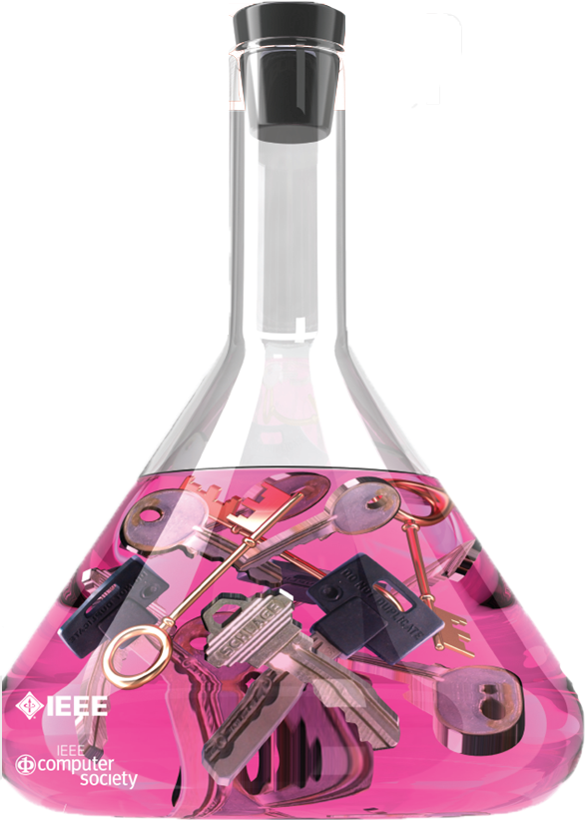
The Science of Cyber Security
Laurie Williams
williams@csc.ncsu.edu
Figure from IEEE Security and Privacy, May-June 2011 issue
Notes:
Hi, I’m here to talk to you about the science of cyber security. Cybersecurity is the body of technologies, processes and practices designed to protect networks, computers, programs and data from attack, damage or unauthorized access by attackers and hackers. Cybersecurity is becoming increasingly important as software pervades every aspect of our lives … from our power grid to our banking to our healthcare systems to our cars. Attackers know they can bring us to our knees with just the right attack. Despite our current efforts at securing our systems and developing secure systems, the attackers are still gaining ground. And, really, the computer industry is playing “cat and mouse” with the attackers where they make a move and we react … they make another move and we react. We really need to get ahead of the attackers. The only way to do so is to understand, fundamentally, the principles and patterns of their actions so we can proactively build secure systems. That is … we need to build a science of cybersecurity.
As I’ll discuss, the US National Security Agency … the NSA … recognized the need to build a science of cybersecurity and has invested quite heavily in such an effort. Louis has spoken about the explicit NSF competition for an Engineering Research Center that NC State has won three times in recognition of our preeminence. In the area of cybersecurity, NC State won a different kind of competition with the NSA. We have a long established relationship with the NSA. When NSA decided to fund a science of security effort they looked to the schools they had confidence in. In the summer of 2010, they played two visits to NC State. We did not understand that we were “on trial” if you will … for a large research effort, but we were. Both times, our faculty made presentations to NSA leaders … being our own natural talented selves. Low and behold that talent and our cybersecurity preeminence …. earned us a place among giants as what is called a NSA Science of Security lablet.

Slide 2
NSA Science of Security Lablet (SoSL)
NSA SOSL lablets:
North Carolina State University (Analytics)
Carnegie Mellon (Scalability, Usability)
University of Illinois (Resiliency)
Projected $2.0-$2.5M funding per year per lablet
NCSU: Based out of Computer Science
14 supported NCSU faculty; 18 supported NCSU students
Multi-disciplinary: 3 NCSU colleges and institutes
5 collaborating university partners
Notes:
As I said, we stand among the giants in our selection by NSA – the other two lablets are Carnegie Mellon and University of Illinois Urbana Champaign. USA Today ranks Carnegie Mellon first in computer science and Illinois 5th. Each of us gets between $2M and $2.5M funding per year. The lablet is based out of the Computer Science department at NC State. We currently support 14 faculty and 18 students with Science of Security projects that are selected by NSA. 3 colleges and institutes are involved (Engineering, Institute for Advanced Analytics, and Humanities and Social Sciences).
The field of the Science of Security is broad. NSA asked the three schools to declare focus areas, which are called “Hard Problems” that we would jointly work on – these are areas of security that we felt are particularly challenging. What I’ll do now is describe the 5 hard problems chosen by jointly by the three lablets.

Slide 3
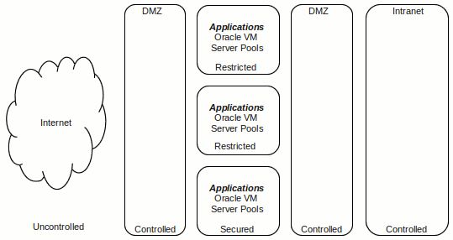
Hard Problem 1: Scalability and Composability
Challenge
Develop methods to enable the construction of secure systems with known security properties.
http://itnewscast.com/book/export/html/62241
Notes:
The first of these is scalability and composability. The idea here is that many systems are actually made up of many other systems that “talk” to each other, if you will. For example in one hospital, there might be one system for the medical records, one for insurance payments, another for prescriptions. Each of those needs to be secure … which is complicated in itself. But, the issue becomes even harder when you put all these separate systems together into larger system … is the system still secure? It’s complicated.

Slide 4
Hard Problem 2: Policy-Governed Secure Collaboration
Challenge
Develop methods to express and enforce normative requirements and policies for handling data with differing usage needs and among users in different authority domains
Notes:
The next problem we call policy-governed secure collaboration. Policies are used to express rules for collaboration. For example, when you go to the doctor, you sign a HIPAA form which specifies the policies the doctor’s office must abide by when using and sharing your medical data. Making sure the software the doctor’s office uses complies with the policies specified by HIPAA is hard. But complying with policies is even more difficult with different users of the same system have different policies. For example, let’s say that NC has policies for sharing medical data that are even more restrictive than HIPAA. One system should act differently for a user when that user is located in NC than in, say Arizona, that must only abide by HIPAA.

Slide 5
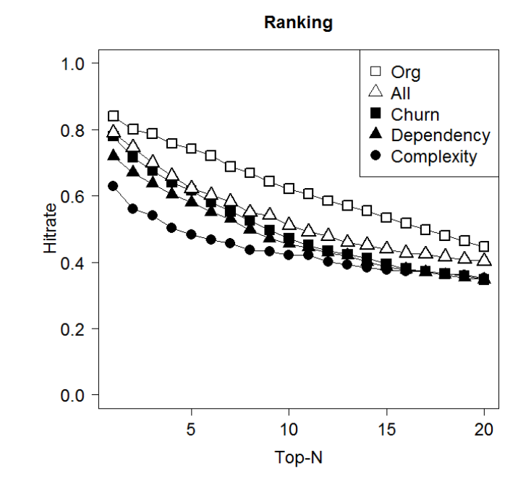
Hard Problem 3: Predictive Security Metrics
Challenge
Develop security metrics and models capable of predicting whether or confirming that a given cyber system preserves a given set of security properties (deterministically or probabilistically), in a given context.
Notes:
The third hard problem we chose is predictive security metrics. Lord Kelvin said, “If you cannot measure it, you cannot improve it.” We are working on defining measure that we can use to predict whether a system is secure or not. We will use these metrics to understand better if a system is secure enough to be used in a customer environment or if the development team needs to work harder to make it more secure.

Slide 6
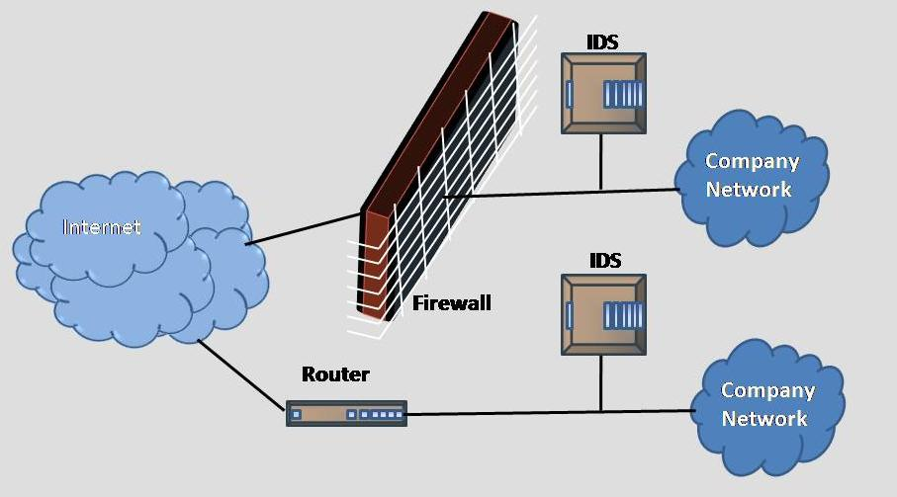
Hard Problem 4: Resilient Architectures
Challenge
Develop means to design and analyze system architectures that deliver required service in the face of compromised components
http://thecybersaviours.com/intrusion-detection-system-ids
Notes:
The fourth hard problem is resilient architectures. This hard problem is about creating systems that will continue to operate properly even if part of the system is under attack. This is similar to fault tolerance in an airplane. Airplanes are designed such that if one engine fails, the other engines take over and the people on the plane land safely, likely unaware that any engine had a problem. Similarly, let’s say Amazon wants to be resilient to attackers so it can continue to sell books even if one server is under attack. The system might detect the attack and allow the attacker to keep attacking that server, but it would send all other users to a different server that is still working so they will not even know an attack is underway and they can continue to buy books.

Slide 7
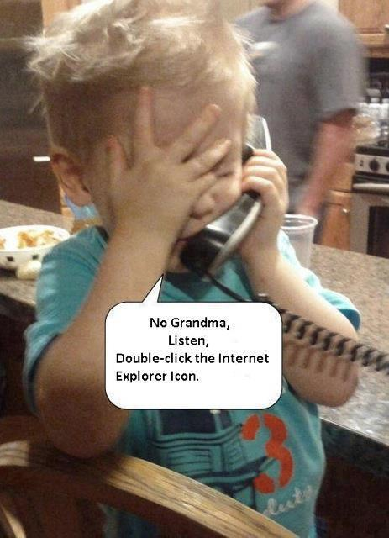
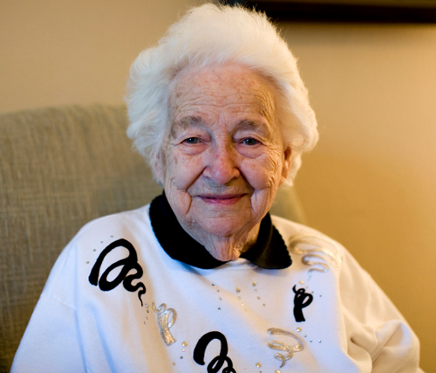
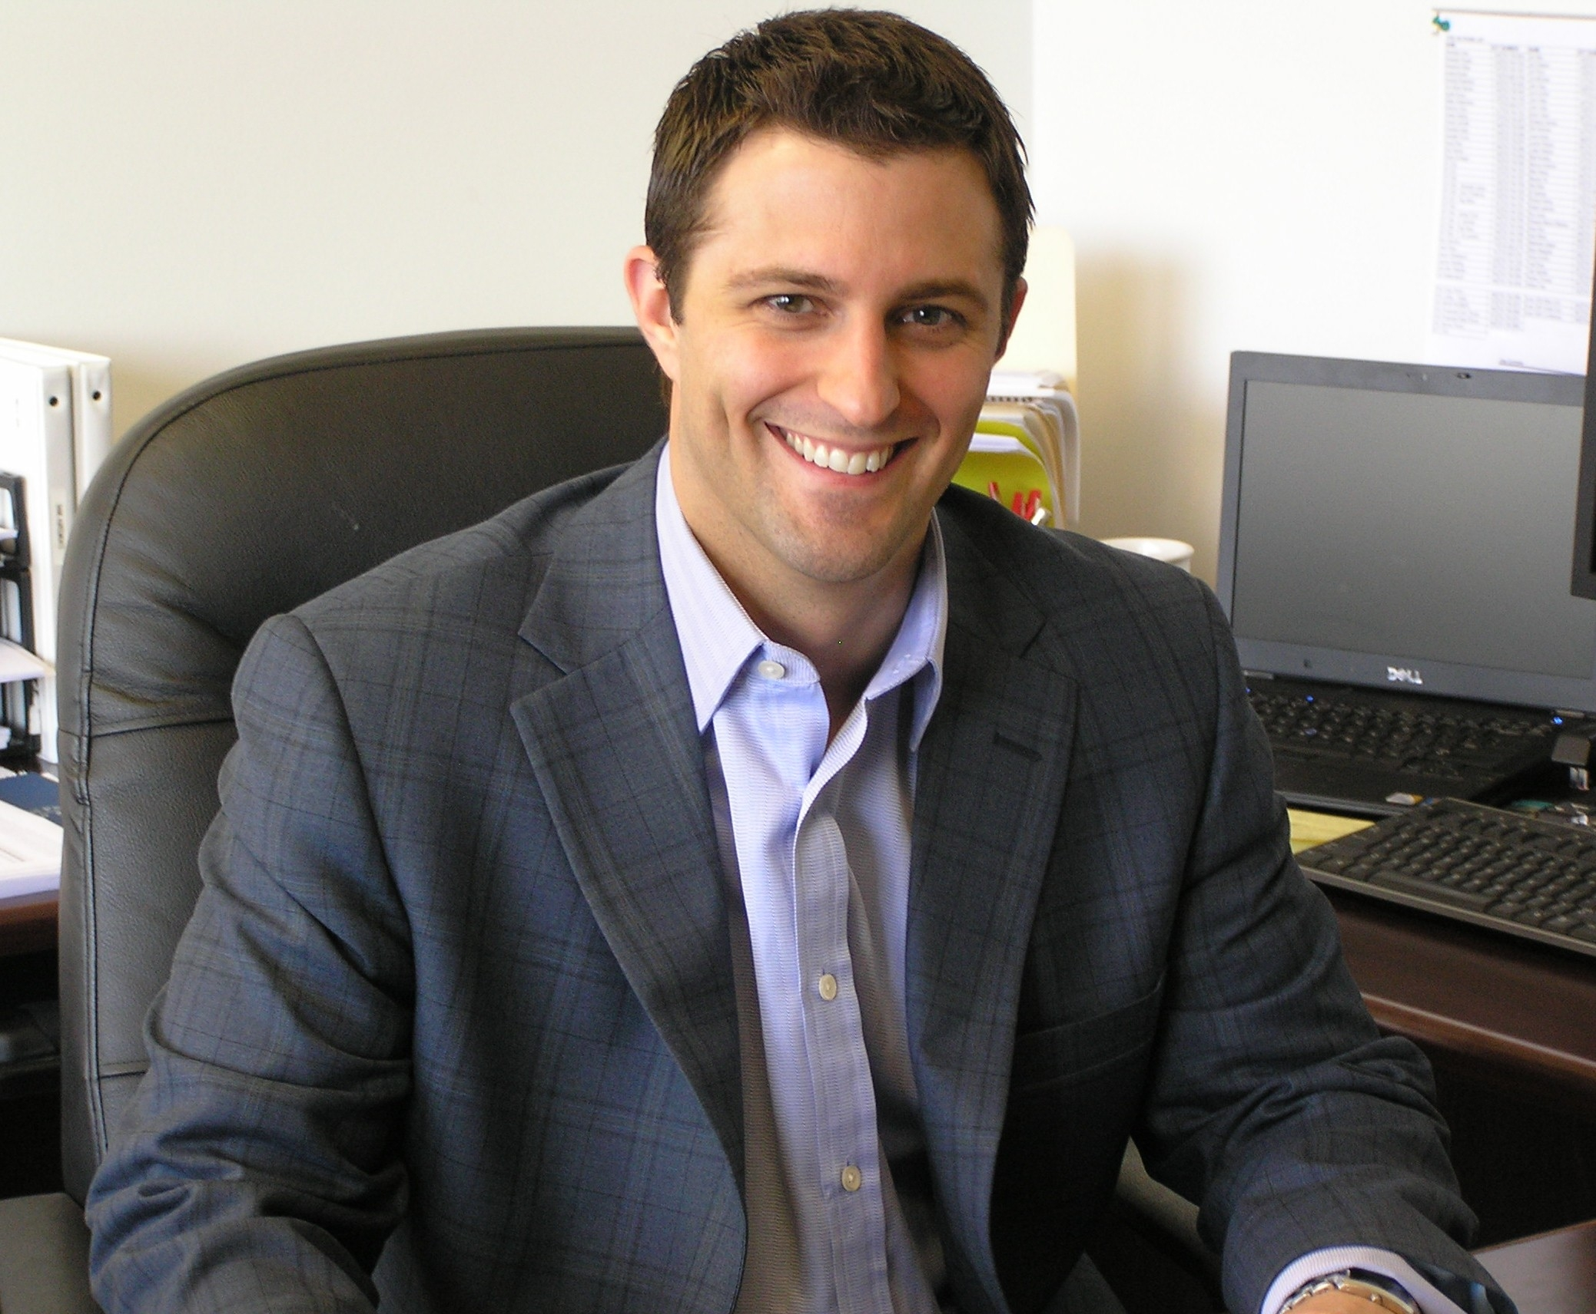
Hard Problem 5: Human Behavior
Develop models of human behavior (of both users and adversaries) that enable the design, modeling, and analysis of systems with specified security properties
http://1000awesomethings.com/2011/02/23/302-grandma-hair/ and http://garysreflections.blogspot.com/2011/02/chinese-hackers-now-hitting-major.html http://www.my-programming.com/2011/10/how-to-become-a-programmer/
http://www.govconexecutive.com/2011/02/executive-spotlight-joseph-cormier-of-gtec/
Notes:
Humans are predictable, computers are not. We are the master of the computer …. We are not masters of the attacker. Currently attackers are far from predictable.

Slide 8
My SOSL Projects
Security Metrics: Non-repudiation metrics
Human Behavior: Security Requirements
Security Metrics/Resilient Architectures: Software Security Engineering

Slide 9
Non-repudiation analysis
Basic Question: Can forensics be performed on your log files?

Slide 10
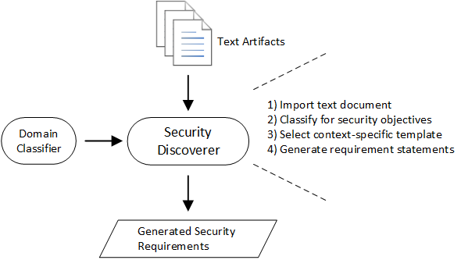
Extracting Security Requirements

Slide 11
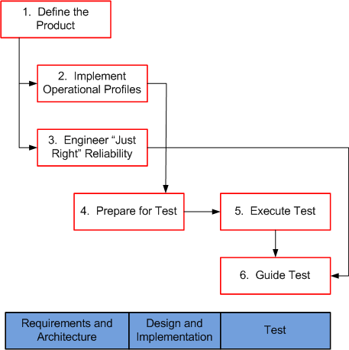
Software Security Engineering
Attack Profile
Vulnerability Intensity Objective
Choose vulnerability prevention & removal practices
Vulnerability prediction models

Slide 12
NCSU Science of Security Community Meeting
Local: October 22, 2013
National: April 8-9, 2013
Let me know if you want to be on the mailing list … williams@csc.ncsu.edu

