Slide 2
North Carolina State University
10 Colleges / 282 Fields of Study / >34,000 students
Among the most productive research universities: >$400M annually in research activities
Patents (>800 U.S.; >1,500 worldwide); >400 consumer products
Top 15 nationally: >800 license agreements with industry partners
Only university leading two National Science Foundation Engineering Research Centers, and one of only three universities to ever house three ERCs
Laboratory for Analytic Sciences (LAS): university-wide initiative with sizable CSC presence

Slide 3
Department of Computer Science
Part of the NCSU College of Engineering
Among the largest and oldest Computer Science departments
Current active research funding ~ $44M
12 research centers and more than 35 labs and groups.
Center for Educational Informatics
Digital Games Research Center
Science of Security Lablet
24 faculty have received NSF Early Career Awards

Slide 4
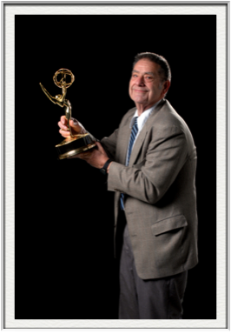
CSC Academic Excellence
NSA Center of Academic Excellence in Information Assurance Research
MCS distance ed degree ranks 3rd by GetEducated.com as “Best Buy Online Graduate Degree in CSC”
MSCN program (joint with ECE)
Game Development Concentration
Dr. Don Bitzer, Distinguished University Research Professor and co-inventor of flat plasma display, awarded an Emmy by the National Academy of Television Arts & Sciences, member of Consumer Electronics Hall of Fame
#1 supplier of new grad talent to IBM, Cisco & NetApp

Slide 5
Key Departmental Stats
#2 in MS Degrees Awarded*
#5 in CSC MS Enrollment*
#5 in CSC Ph.D. Enrollment*
#11 in CSC Undergraduate Enrollment*
#15 in CSC BS Degrees Awarded*
#11 in CSC Research Expenditures*
40+ faculty, 5 emeritus faculty, 5 lecturers & adjuncts, 30+ research, IT and administrative staff
Average Starting Salaries - Dec 2013 $65,700 for BS, $93,000 for MS
*ASEE Data 2012

Slide 6
Available Talent for Research
Faculty: 40
PhD students: 171
MS students: 35
MSCN students: 35
MCS students: 307

Slide 7
Agenda
8:30 Welcome & Opening Remarks 8:45 Dr. Nagiza Samatova, Analytics-Driven Data Management at Exascale 9:00 Dr. Michael Young, Computer Games Research 9:15 Dr. Rudra Dutta, Networking Frontiers: Architecture, Software, Ubiquity 9:30 Dr. Randy Avent, NC State University Initiatives in "Big Data" 9:45 Dr. Ben Watson, User Experience Research at NC State 10:00 Dr. Munindar Singh, Text Analytics for Sentiment 10:15 Break 10:45 Dr. Laurie Williams, The Science of Security 11:00 Dr. Tiffany Barnes, Supporting and Studying Learning: Games and Learning Analytics 11:15 Dr. Blair Sullivan, Scalable Graph Algorithms 11:30 Dr. Chris Healey, Social Network Visualization 11:45 Dr. Kemafor Anyanwu, Semantics in Big Data Analysis 12:00 Closing 12:15 Lunch 1:15 Meetings with individual faculty 2:45 Ice Cream Break

Slide 8
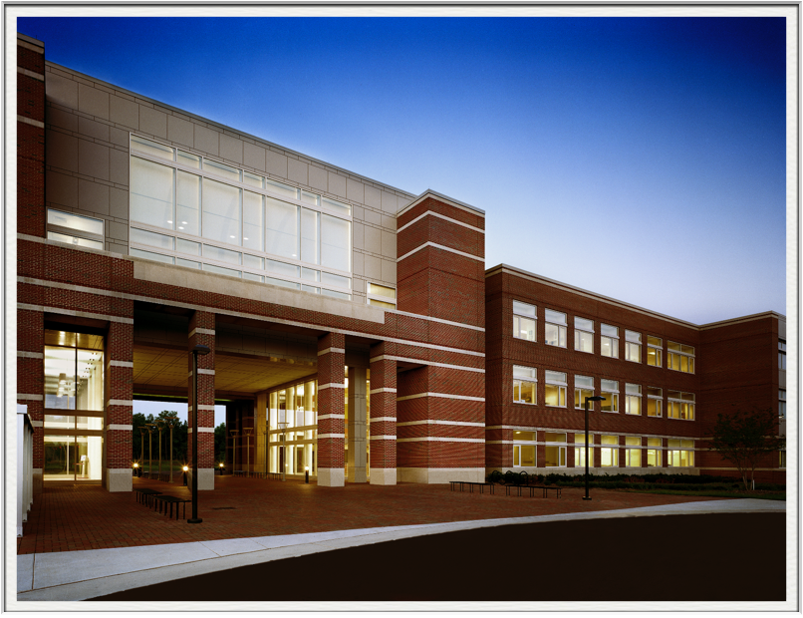
EB2 - Home of Computer Science
210,000 sq. ft.
50 Teaching & Research Labs
Nine Classrooms w/ 785 Seats
DELTA Classroom
Port City Java

