Slide 1
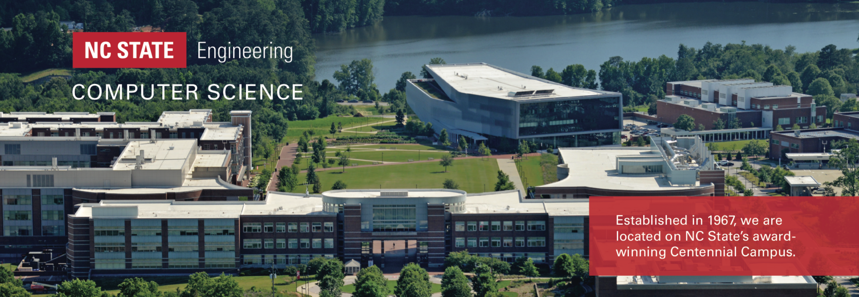
Computer Science Graduate Programs
Steffen Heber
Director of Graduate Programs

Slide 2
Agenda
Team Intro & How to contact us
The CSC Department
Our Graduate Programs
Advising & Resources
Phishing, Scams & Unsolicited Emails

Slide 3
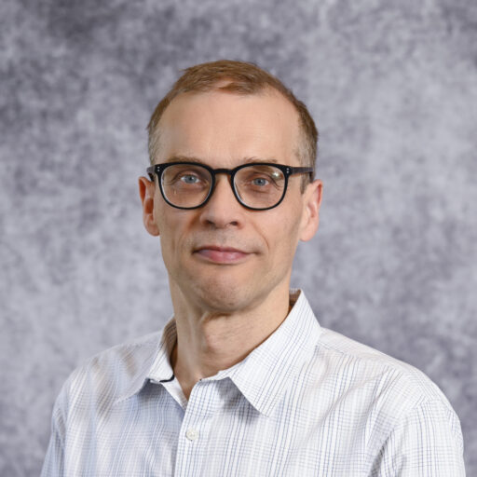
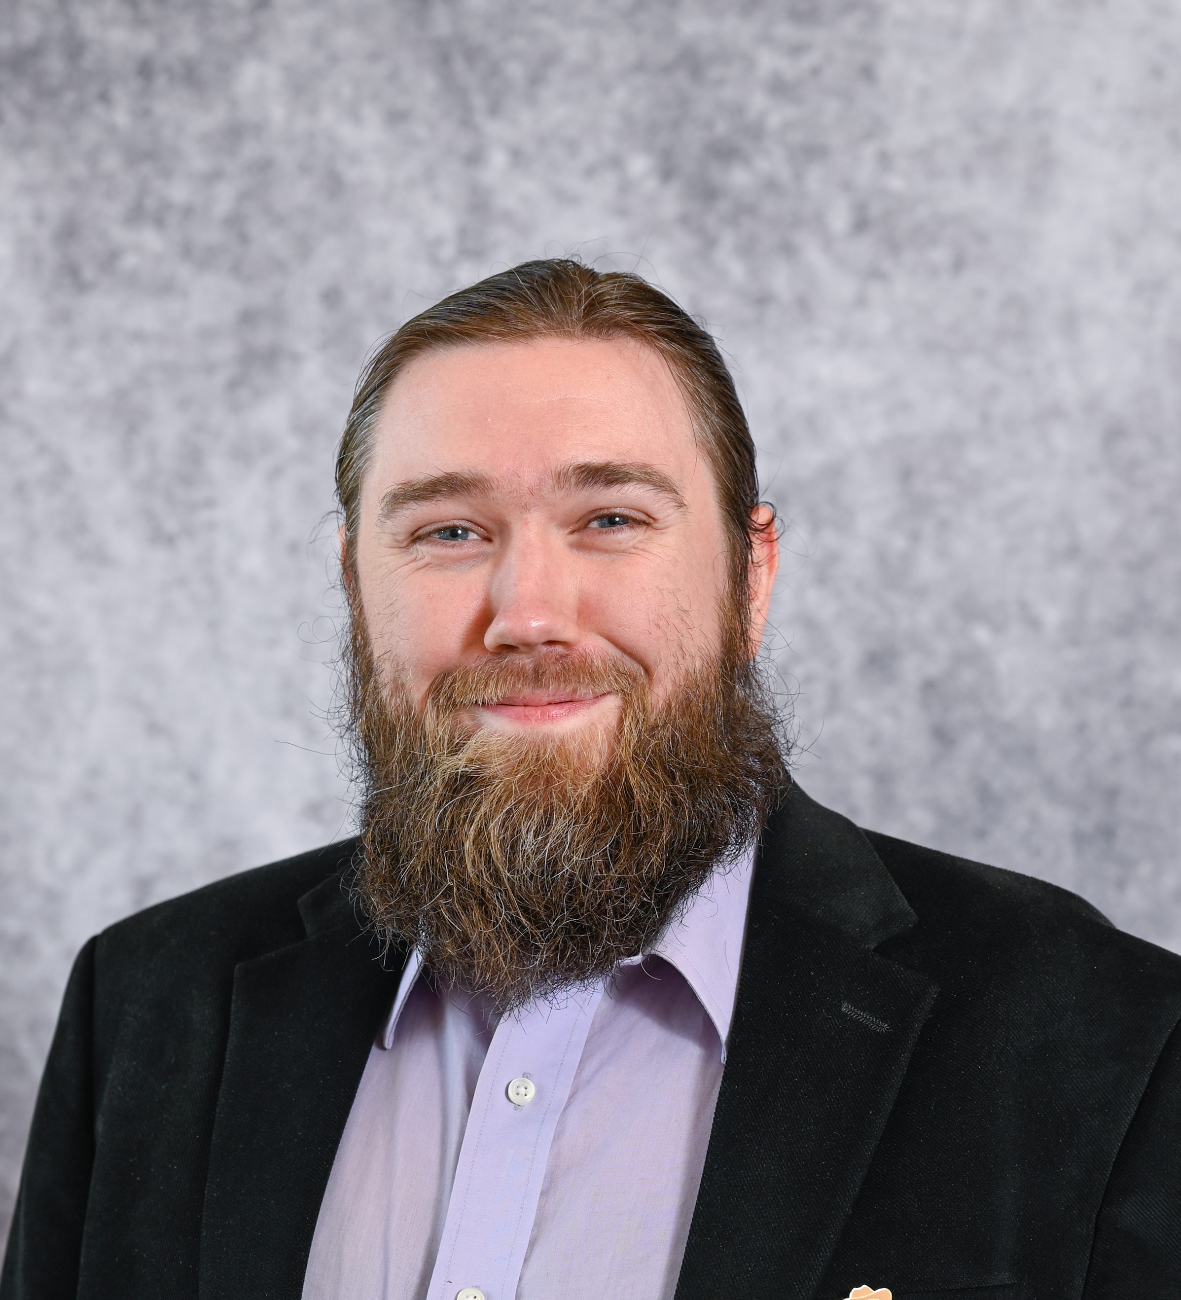
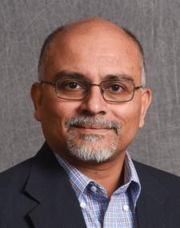
Advising Team
Dr. Steffen Heber
Director of Graduate Programs
Professor
Advises PhDs
Dr. Alexander Cards
Assistant Director of Graduate Programs
Asst Teaching Professor
Advises Masters students
Dr. Rudra Dutta
Associate Department Head
Professor
Advises MSCN students

Slide 4
Dr. Heber’s Contact Information
Director of Graduate Programs
Website: sheber.wordpress.ncsu.edu
Office: 2306 EB-II
Email: dgp@csc.ncsu.edu
Phone: 919-513-1118
Zoom PMI: 694 362 4188
Office hours (walk-ins & appointments): M/T/Th 1:30 PM-2:30 PM
Calendar: my.csc.ncsu.edu/dgp → services-info-for-students → dgp-calendar

Slide 5
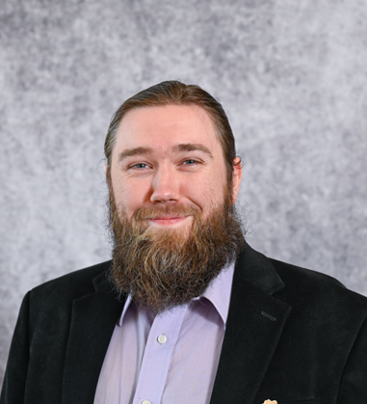
Dr. Card’s Contact Information
Assistant Director of Graduate Programs
Office: 2292 EB-II
Email: csc-grad-advising@ncsu.edu
Phone: 919-515-2017
Office hours (walk-ins): M/W 10:00 AM-11:00 AM
Office hours (appointments, Calendar link): M/W 11:00 AM-12:00 PM

Slide 6
Dr. Dutta’s Contact Information
Associate Department Head
Office: 2402-C EB-III
Email: rdutta@ncsu.edu
Phone: 919-515-8650
Office hours: TBA

Slide 7
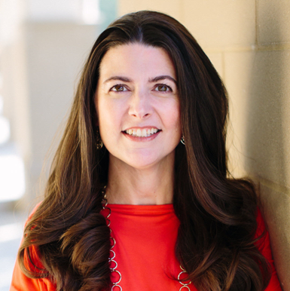
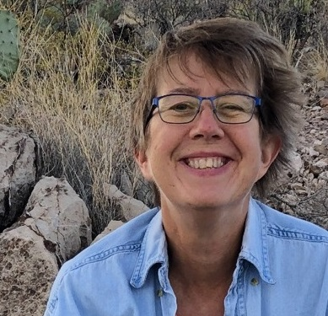
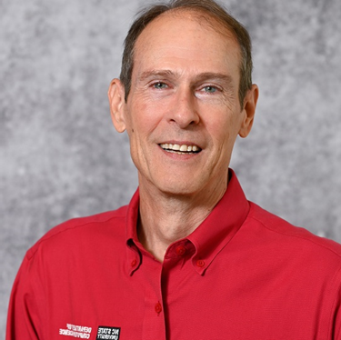
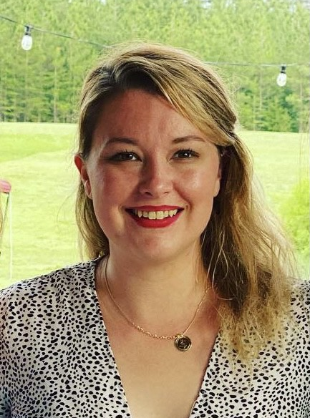
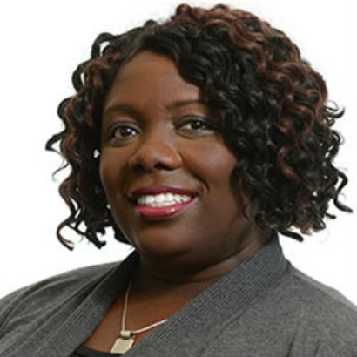
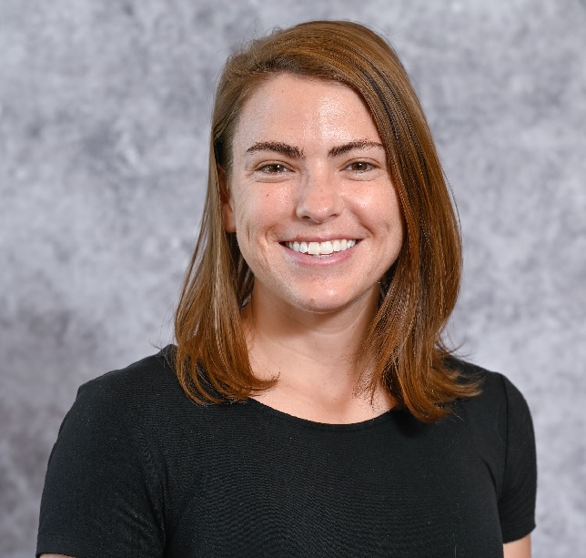
Our Team
Leslie Rand-Pickett Director of Graduate Career Services
Interim Director External & Corporate Rel.
Kathy Luca
Graduate Program Support Specialist
Andrew Sleeth
Graduate Admissions Manager
Sarah Miller Student Services Specialist
Kiresten Branch
Graduate Service Coordinator
Cara Glover
Graduate Admissions Specialist

Slide 8
Our Team
Leslie Rand-Pickett Director of Graduate Career Services
Interim Director External & Corporate Rel.
Graduate Admission Office
Kathy Luca
Graduate Program Support Specialist
Andrew Sleeth
Graduate Admissions Manager
Graduate Office
Sarah Miller Student Services Specialist
Kiresten Branch
Graduate Service Coordinator
Cara Glover
Graduate Admissions Specialist

Slide 9
Contact
For admission questions, contact csc_gradadmissions@ncsu.edu.
For academic advising:
PhD students: contact Dr. Heber dgp@csc.ncsu.edu.
Non-thesis Masters students: contact Dr. Card csc-grad-advising@ncsu.edu.
MSCN students: contact Dr. Dutta rdutta@ncsu.edu
For other questions unrelated to admissions or academic advising, contact csc-gradoffice@ncsu.edu.
The instructor if course related
For internship & employment questions, contact Leslie Rand-Pickett

Slide 10
Try a Web Search first …
Information you need is probably on one of these websites
csc.ncsu.edu → Academics → Graduate Program → …
my.csc.ncsu.edu/dgp → services-info-for-students
internationalservices.ncsu.edu → OIS visa, employment etc.
catalog.ncsu.edu → graduate → graduate-handbook
ncsu.edu and then do a search

Slide 11
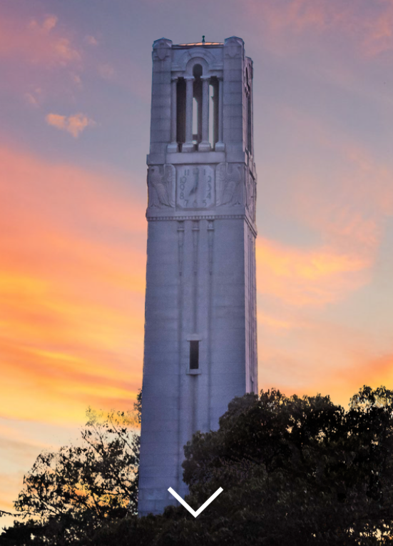
North Carolina State University
Nationally recognized leader in Science & Technology Education and Research
12 Colleges, >300 Fields of Study, ~38,500 students
~$580M in Annual Research Expenditures, among most productive research Universities: 1,500+ patents, 170+ startups launched, > 600 consumer products to market

Slide 12
Department of Computer Science
Founded in 1967 – Among the nation’s Oldest and Largest
Over $18.6M in Research Expenditures
$20M NSF AI Institute / $2M NSA Cybersecurity Grant
13 Research centers and >35 Research Labs & groups
36 faculty with NSF CAREER Awards
One of leading producers of CS graduates in the US
Top supplier of new grad talent to IBM, SAS, Red Hat, Cisco, NetApp
#1 in tenure-track female faculty among CS Departments in Colleges of Engineering

Slide 13
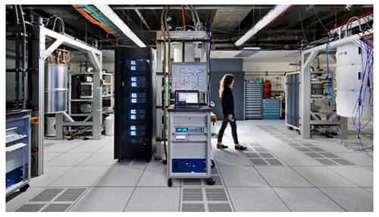
Key Departmental Stats
Total Fall 2024 enrollment: ~2800
~240 PhD, ~760 Masters, ~1800 Undergrad
Faculty: 63 +10 Adjuncts, 16 Teaching
Res/IT/Admin staff: 40+
#1 in High-Performance Computing Research
#2 in Computer Science Education Research
#4 Software Engineering Research
#7 in Embedded & real-time systems Research
#12 in Computer Architecture Research
#17 in Systems Research

Slide 14
Research Areas
Advanced Learning Technologies
Algorithms and Theory of Computation
Architecture and Operating Systems
Artificial Intelligence and Intelligent Agents
Cloud Computing
Computer and Video Games
Cyber Security
Cyber-Physical Systems
Data Sciences and Analytics
Embedded and Real-Time Systems
Graphics, Human Computer Interaction, & User Experience
Health Care Information Technology
Information and Knowledge Management
Networking and Performance Evaluation
Parallel and Distributed Systems
Quantum Computing
Scientific and High-Performance Computing
Software Engineering and Programming Languages
https://www.csc.ncsu.edu/research/areas.php

Slide 15
Major Growth Trend
Engineering Expansion
4K new students in Engineering/CS over five years
 | Fall 2020 | Fall 2021 | Fall 2022 | Fall 2023 | Fall 2024
Master’s | 332 | 496 | 638 | 660 | 763
Ph.D. | 205 | 204 | 208 | 221 | 241
TOTAL | 537 | 700 | 846 | 886 | 1004
Undergraduates | 1329 | 1472 | 1690 | 1785 | 1763

Slide 16
Graduate Degrees
PhD
Master of Computer Science (course-based)
Track in Data Science
Track in Security
Track in Software Engineering
MS in Computer Science (thesis-based)
MS in Computer Networking
MS in Cybersecurity (approval pending)
Graduate Certificates
Computer Science
Data Science Foundations
Cybersecurity

Slide 17
Graduate Enrollment Breakdown
 | New | Continuing | Total
PhD | 66 | 175 | 241
Masters | 313 | 444 | 757
MS | 2 | 6 | 8
MCS | 297 | 390 | 687
MCS-DE | 14 | 48 | 62
Certificates | 6 | 5 | 11
CTG-CS-DE | 1 | 3 | 4
CTG-CYS | 2 | 1 | 3
CTG-DSF | 3 | 1 | 4

Slide 18
PhD Degree
An advanced research degree.
Work in cutting-edge areas with world-renowned faculty
4-year funding guarantee
Competitive stipend + tuition remission + health insurance
72 credits / 54 with a related Masters
Only 18 course credits required
Three research milestones
Qualifying exam, Research proposal, Defense
Median time to degree: 5.5 years

Slide 19
PhD Curriculum Requirements
Must have attended 8 seminars
core course GPA ≥ 3.5, overall GPA ≥ 3.0
Requirement | Credit Hours
Orientation course (CSC 600) | 1
4 Core courses (2 in Theory, 2 in Systems) | 12
2 CSC 700-level courses | 6
Written Qualifying Exam (CSC 890) | 6
CSC graduate electives / research credits | 47
Total | 72

Slide 20
Details
Two CSC 700-level courses; one can be a CSC 791 special topics course (needs approval)
CSC graduate electives: graduate 500- and 700-level CSC courses
Research credits: CSC 830, CSC 893, CSC 895, CSC 896

Slide 21
PhD Timeline
Find an advisor and engage in research -> CSC 801, CSC 830
Take core courses during the first 27 credit hours.
Qualifying (written prelim) exam before the 5th semester (4th semester if you have a related MS) -> CSC 890
Form Advisory Committee, file Plan of Work
Research proposal (oral prelim exam) by 8th semester or 48 credit hours, at least one semester before defense
Final Oral Exam (Defense)
Dissertation (ETD submission and approval, ETD Deadlines)
Graduation

Slide 22
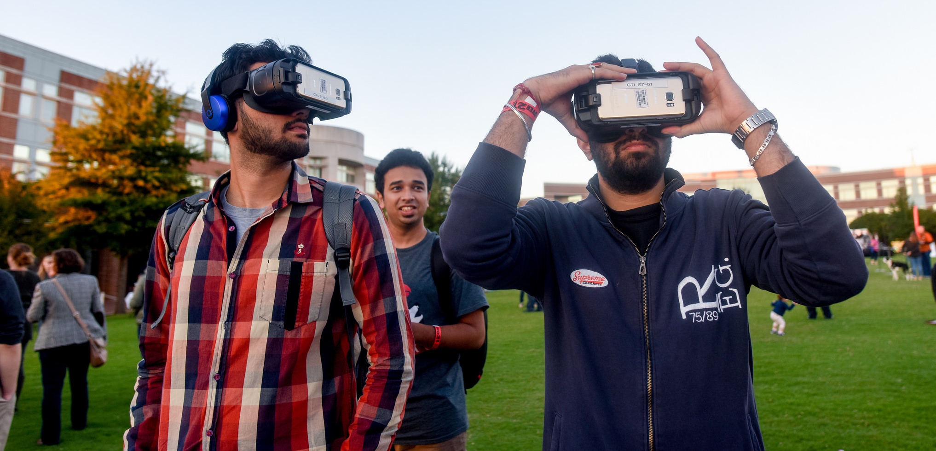
Masters Degrees
31 credits: 10 courses OR 8 courses+thesis
All courses must be taken for letter grade
Must maintain GPA >= 3.0
Independent study option
Full-time enrollment: 9 credits
Complete degree in 3 or 4 semesters
Summer or semester internship (CPT) options

Slide 23
Master of Computer Science (MCS)
The MCS is a coursework-based terminal professional degree. No research, thesis, or comprehensive examination is required. The degree is offered on-campus or via DE.

Slide 24
MCS Curriculum Requirements
core course GPA ≥ 3.0, overall GPA ≥ 3.0
Requirement | Credit Hours
Orientation Course (CSC 600) | 1
3 Core courses (1 in Theory, 2 in Systems, or vice versa) | 9
CSC graduate electives | 12
CSC graduate electives, or “restricted” electives | 9
Total | 31

Slide 25
Details
At least 21 credits letter-graded (500- or 700-level) CSC course
Restricted electives: graduate letter-graded (500- or 700-level) course within the College of Engineering (including Computer Science) or the College of Sciences. No special topic courses other than CSC courses.
At most, 4 CSC special topics courses (CSC 591 or CSC 791)
3 credits Independent Study (CSC 630) are allowed

Slide 26
Master of Computer Science (Distance Education, MCS-DE)
Available to US citizens and permanent residents, US military personnel serving overseas, and foreign nationals residing in the US on qualifying non-student visas.
Courses are streamed through Engineering Online (EOL).
MCS-DE students may attend on-campus courses as well.
Diploma and transcript list the degree as Master of Computer Science.

Slide 27
Three MCS Master Tracks
Data Science
Security
Software Engineering
Students must satisfy all the MCS requirements, plus additional, track-specific constraints.
Upon completion, students may request an official letter from the Graduate Office. The letter will mention you by name, your degree program, and that you have successfully completed the Masters Track.

Slide 28
Master of Science (MS) in Computer Science
The MS in Computer Science is a research-oriented degree. The degree has two components: completion of a designated curriculum and completion and defense of a thesis that describes original research.

Slide 29
MS Curriculum Requirements
core course GPA ≥ 3.0, overall GPA ≥ 3.0
Requirement | Credit Hours
Orientation Course (CSC 600) | 1
2 Core courses (1 in Theory, 1 in Systems) | 6
CSC graduate electives | 9
Thesis research (CSC 695 ) | 6
Minor courses, CSC graduate electives, or “restricted” electives | 9
Total | 31

Slide 30
Details
At least 12 credits letter-graded (500- or 700-level) CSC course
Restricted electives: graduate letter-graded (500- or 700-level) course within the College of Engineering (including Computer Science) or the College of Sciences. No special topic courses other than CSC courses.
At most, 4 CSC special topics courses (CSC 591 or CSC 791)
At most 6 credits for thesis research (CSC 695), and 3 credits in 600-level work, e.g., Independent Study (CSC 630)

Slide 31
Four Semester Timeline: MCS ⇒ MS
1st semester: contact prospective advisor(s) mid-semester
2nd semester: sign up for CSC 630, independent study
3rd and 4th semesters: sign up for 3 hours of CSC 695 each
if 2nd semester doesn’t work out, can still use CSC 630 toward MCS
form advisory committee (3 members at least 2 CS) and develop POW
write thesis
schedule Final Exam (Defense)
Thesis submission and approval (ETD Deadlines)
Graduation
Tip: before contacting a thesis / independent study advisor
do your homework: read abstracts of their recent papers
be prepared to show interest and ask questions
degree change paperwork is easy → graduate office

Slide 32
Not Discussed Here
Master of Science in Computer Networking
Master of Science in Computer Networking (Distance Education)
Master’s degree in Foundations of Data Science (MSFDS)
Master’s degree in Foundations of Data Science (Distance Education)
Certificates
Computer Science
Cybersecurity
Data Science Foundations

Slide 33
Summer or Semester Internship
International students who want to work off-campus can do this via Curricular Practical Training (CPT).
Full-time (usually, during summer) or part-time (during academic year).
International students who must be registered full-time must
have completed two semesters of study
be in good academic standing (GPA ≥3.0)
Students with 3.0-3.2 GPA must receive approval from the DGP or their graduate advisor.
Students must be registered in at most 3 graduate-level courses during a part-time (≤20h) internship

Slide 34
CPT Resources
Curricular Practical Training | Office of International Services (ncsu.edu)
CPTs | Computer Science Graduate Program (ncsu.edu)
Fall/Spring Internship/co-op | CSC Careers (ncsu.edu)

Slide 35
Services/Info for Students
The dgp site contains a plethora of relevant information.
Credit transfers for Masters
Credit transfers and course waivers for the PhD
Registration in research credits (“department approval required” courses)
Schedule Revision After Census Day
Requesting leaves of absence
Academic difficulty
Degree changes or additions
Fellowship opportunities
Procedure to add the MS “En Route”
Tuition Support Past GSSP Eligibility
…

Slide 36
General Academic Advice
In your courses,
keep up with material
pretend there is a test at the end of every week
form study groups to brainstorm questions …
but homework and programs are individual work …
… unless instructor specifies otherwise
read Code of Student Conduct (especially Section 8)
seek diversity – join project teams with people not like you
Communication skills are extremely important
Resources for finding an advisor: PhD Advisor Information | Computer Science Graduate Program (ncsu.edu)

Slide 37
Reduced Course Load
If you can’t cope with your workload, less than full-time enrollment MAY be authorized for
Medical Reasons
Academic Hardship (language problems, incorrect placement)
Final Semester
Take action BEFORE you get into serious problems!

Slide 38
More Advice: Being a student can be stressful …
Get enough sleep
Physical activity: walking, running, swimming, yoga, sport, physical education course, musical instrument
Support group: friends, spiritual community, clubs
Volunteer work (not too much ☺)
Get help as soon as you need it: no shame in anxiety, depression, etc.

Slide 39
If It is Too Good To Be True … Beware of Phishing and Scams!
Recognize the Signs:
Unexpected emails/calls/texts asking personal or financial information.
Urgent/threatening language: "Act now, or your account will be closed!"
Unfamiliar links or attachments.
Protect Yourself:
Never share passwords, Social Security #s, or credit card details.
Don’t click on links or attachments from unknown sources.
Verify the sender before responding.

Slide 40
On-Campus Jobs – DON’T SPAM CONTENT
Avoid unsolicited mass emails - don’t email faculty broadly asking for part-time work or research experience.
We receive complaints from our colleagues. IT has set up an account to report these messages and take action.

Slide 41
Why Mass Emails Don’t Work
Impersonal, often ignored or marked as spam.
Damage your professional reputation.
→ Mass emails are counterproductive!

Slide 42
What to Do Instead
Network through LinkedIn or industry events
Research opportunities
Tailor each email to the opportunity
Send concise, personalized messages
Follow up, but avoid being overly persistent
Build relationships

Slide 43
Resources for Finding Work
On-campus
On-Campus Jobs | CSC Careers (ncsu.edu)
On-Campus Employment Opportunities for Masters Students | Computer Science Graduate Program (ncsu.edu)
Off-campus
Student Employment Opportunities | Computer Science Graduate Program (ncsu.edu)
Internship & co-op
Fall/Spring Internship/co-op | CSC Careers (ncsu.edu)

Slide 44
One More Thing: Important Dates
Aug 23 Last Day to add a course without permission of instructor (end of first week) → you might not get into courses afterward
Aug 30 Census Day / Official Enrollment Date (end of second week) → last day to add a course with instructor permission, GSSP exception deadline, last day to drop without a W grade
Oct 17 Drop / Revision Deadline (8 weeks in) → last day to change to credit only
Nov 1 Apply to Graduate Deadline → last day to apply for graduation, first ETD deadline
More ETD deadlines

Slide 45
Thank You!
Questions?

Slide 46
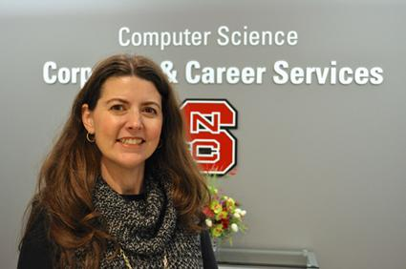
Career Services
Career fair prep, Resumes, Interviewing, Internship searching, Salary & Offer negotiation, …
Video tutorials/workshops
Quinncia Resume & Interview software
Slack workgroup with channels for specific topics
Tailored resources: go.ncsu.edu/csccareer
Employment reports for CS graduate students
High-tech rooms with remote interview capabilities
Only known dept on campus to provide such services

Slide 47
Corporate Relations
100+ Companies
Outreach & Student Recruitment
Sponsorships
$1M+ Last 6 Years

