Slide 1

Carlos Benavente – CSC IT Manager cabenave@ncsu.edu csc_help@ncsu.edu
2025 NCSU Computer Science Graduate Student Orientation

Slide 2
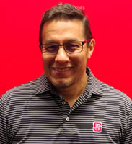

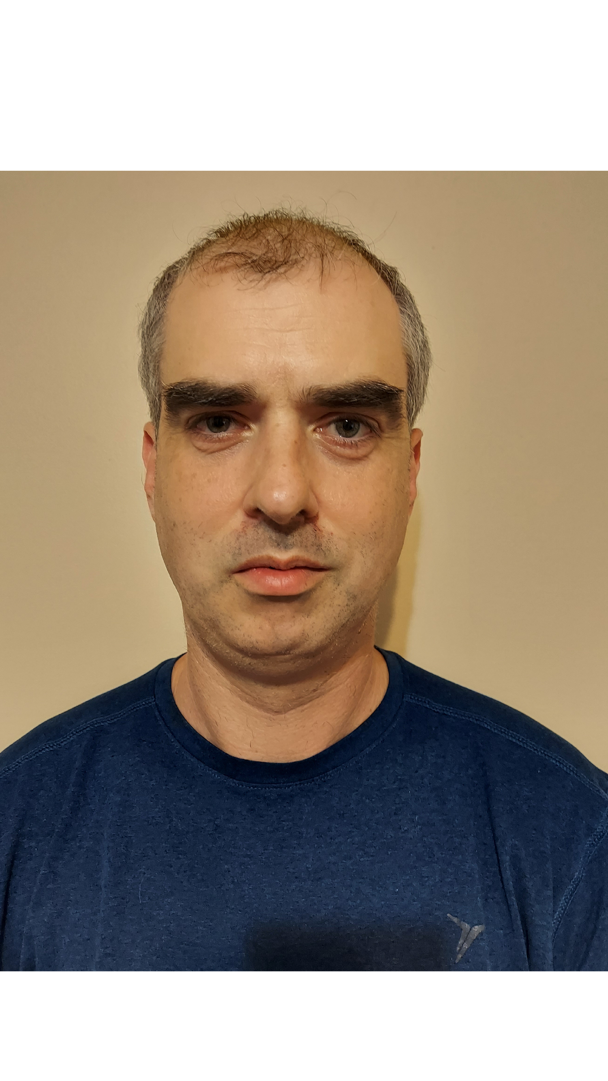

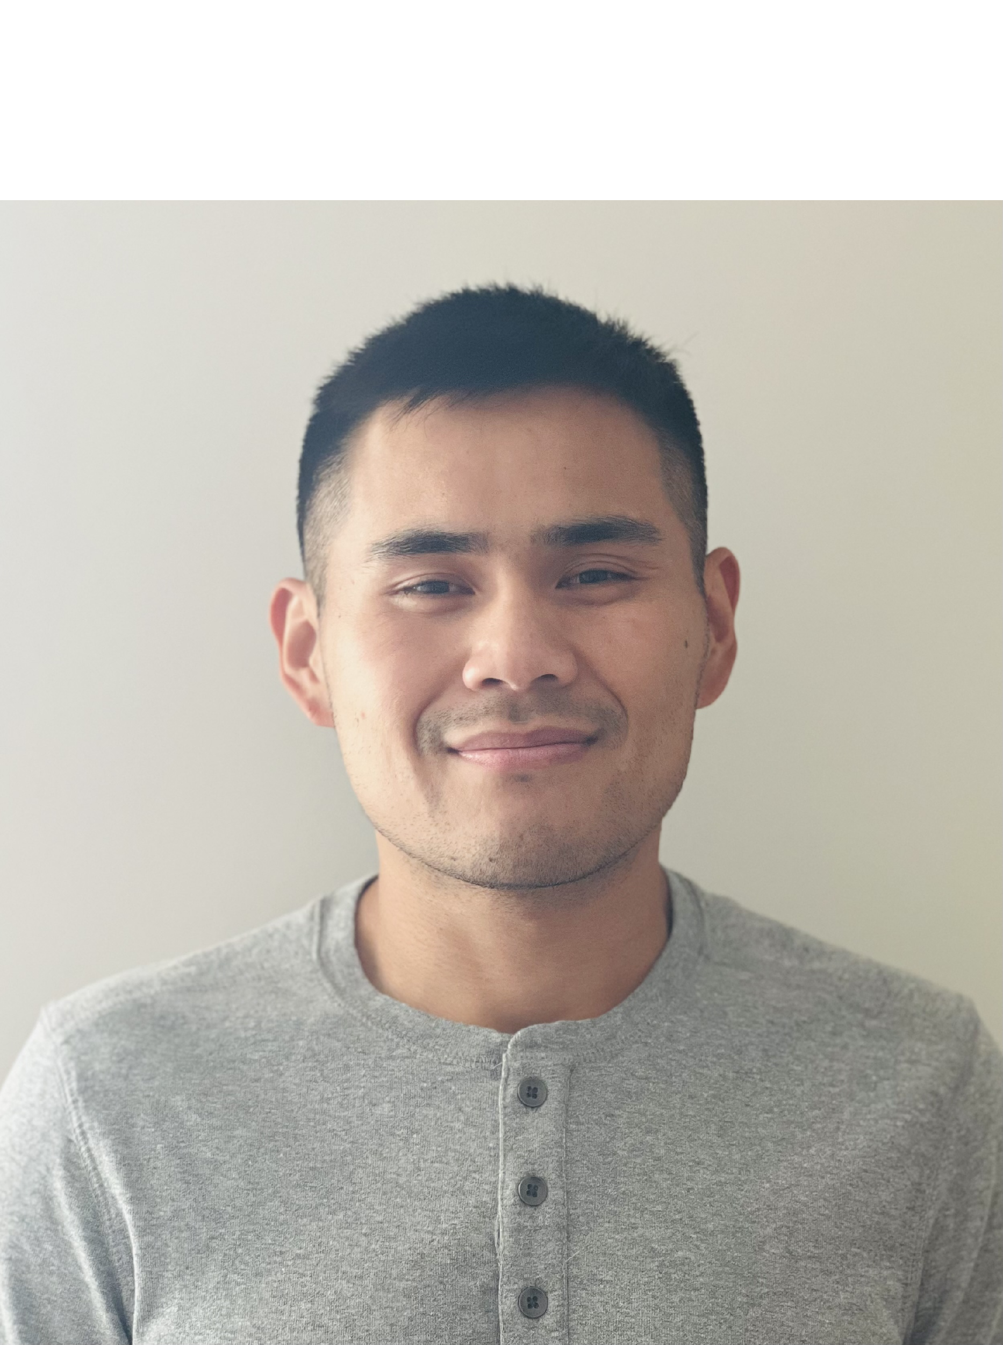
CSC IT Team
Manager (Carlos Benavente)
Enterprise Infrastructure Administrator (Trey Murdoch)
Linux Administrator (Tim Andrews)
System (Mac & Windows) Administrator (Tyler Puckett)
Desktop Support Administrator (Trung Dang)
DevOps Admin (Jordan Horrall)
Student Temp Employees
https://it.csc.ncsu.edu/

Slide 3
What Do We Support?
Departmental-owned: Desktops, laptops, server-class equipment, smartphones, tablets, & printers
OS Support: Linux, Windows, and Mac
Virtualization & Hosting services on prem (VMWare + Proxmox)
Computer Teaching Labs Support
Computer configuration consultation and purchasing
Network support in CSC Spaces
Security - provide technical guidance and configuration to protect university data and networks
Surplus and Hardware Decommissioning
Management of ALL Departmental Web tools and email lists

Slide 4
Who to Contact for IT Support?
For CSC-specific IT support, contact csc_help@ncsu.edu
For all other general IT support: contact OIT: help@ncsu.edu (919) 515-HELP(4357)
Walk-in Centers see: https://ncsu.service-now.com/sp/en?id=service_page&service=9ae96b89db9a5090efb541db139619f1

Slide 5
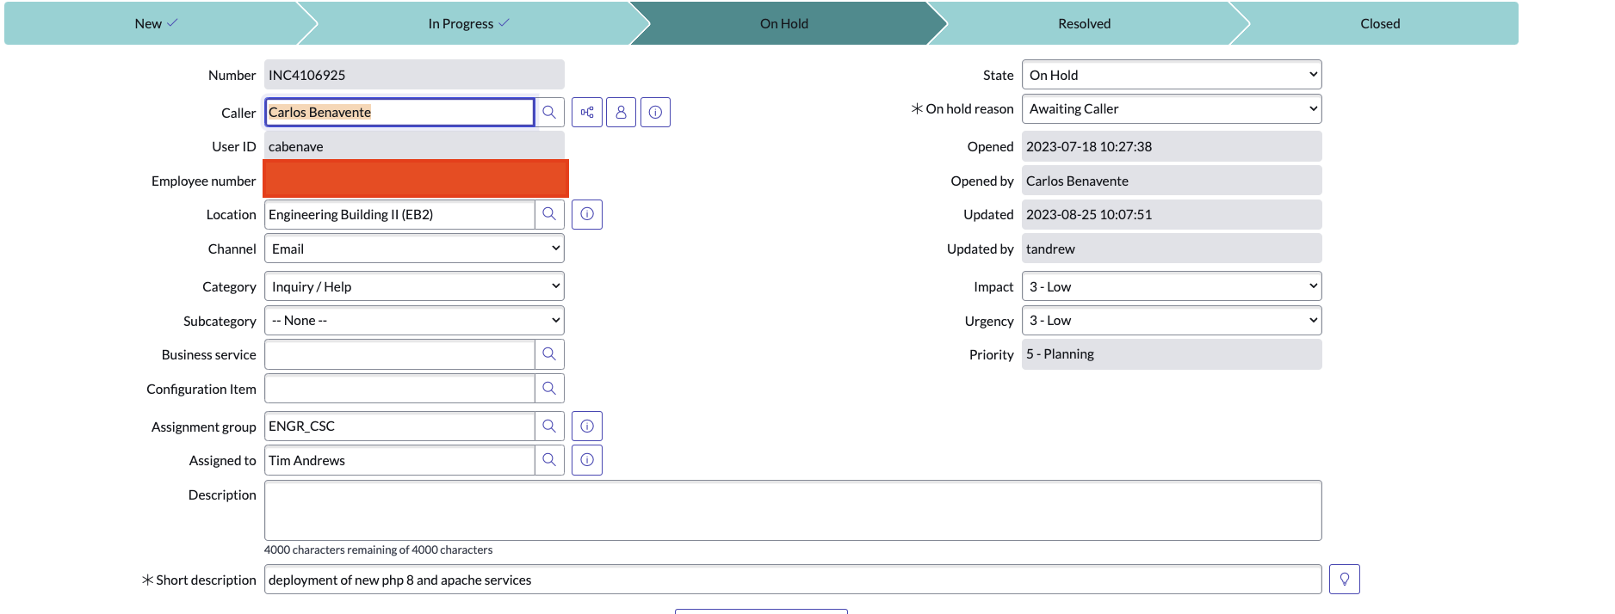
csc_help@ncsu.edu --> ServiceNow
Campus-wide Incident Response/Tracking System
Use your @ncsu.edu account when submitting help tickets.

Slide 6

Reporting IT Issues
1st Search OIT’s knowledge Base at https://ncsu.service-now.com/sp?id=kb_home
When submitting Help tickets:
  Use your university email account: UnityID@ncsu.edu
  Specify: Personal or Departmental-owned computer?
  Physical location
  Computer Number/TAG
  What OS?
  Error Messages
  Things you have tried
  “My Computer Doesn’t Work”, “I need help with my software installation” It is not very helpful

Slide 7
CSC and Other Campus IT Facilities
CSC Server Rooms: for on-prem server equipment
TA offices: equipped with desktop and scanner (check with your advisor)
Poster printer: (EB2 3rd Floor Mailroom) – See admin staff Carol Allen @ EB2 3320. Options: Hunt Library and Fitts Wollard Hall
Teaching/Computer Labs: EB2 1221, Lampe Drive 255, 200, 201, Ventures IV
CSC Public Desktops: EB2 1235 (end of hallway): 1 Windows and 1 Linux
For additional CSC facilities: https://it.csc.ncsu.edu/infrastructure/
College of Engineering Labs (EOS Labs): https://it.engr.ncsu.edu/computing-labs/
Technology Lending at Hunt Library: https://www.lib.ncsu.edu/huntlibrary/technology
ITECS Equipment Loan Program: https://docs.google.com/forms/d/e/1FAIpQLSdLh3pDRjFWZafabrBClF47P5xW7RkKv9YrqojBtRTyShAdGg/viewform

Slide 8
RULES AND POLICIES

Slide 9
Endpoint Protection Standard (EPS)
“University Rule”
RUL 08.00.18 - Endpoint Protection Standard (EPS) requires users take appropriate security precautions when interacting with university data.
The EPS applies to all devices that access university data, regardless of who owns them.
The standard also specifies that all university-owned devices be managed by a CMS (Configuration Management System) if one is available for that platform.
EPS requires “security controls” regardless whether it is a university owned endpoint or not.
Exception Process exists.

Slide 10
Endpoint Security Controls
Some Examples of Security Controls:
  Anti-malware & antivirus software
  Login Authentication
  Encrypted Network Communication
  HD encryption
  Host-based firewall
  Least Privilege Access
Endpoint Protection Standard - Security Controls

Slide 11
Data Sensitivity Framework
Data sensitivity levels:
Ultra-sensitive – Purple (Examples: SSNs, PINs, passwords, credit cards, digital signatures, biometric data)
Highly sensitive – Red ( Examples: personal information regarding health, financials, identity)
Moderately sensitive – Yellow (Examples: education-related data and any data that would affect university business if disclosed inappropriately - grades, course schedule, student ID)
Normal, not sensitive – Green (Examples: published university web content and any data that would not affect university business if disclosed - preferred email address, grade level - undergrad, grad)
Unclassified– White (Examples: static content published on university web pages)
Endpoints storing sensitive data:
Accessing and storing purple university data is prohibited on non-university-owned endpoints.
Storing red university data is prohibited on non-university-owned endpoints
See Storage Locations for University Data
Notes:
In order to protect university data assets and meet applicable federal, state, regulatory and contractual requirements; we (employees & students) need to protect university data from theft, compromise, or inappropriate use. The Data Sensitivity Framework allows users to assess its sensitivity level and secure it accordingly from risks which may include, but not be limited to, unauthorized destruction, modification, disclosure, access, use and removal.

Slide 12
RULES/POLICIES (continuation) - DOs & DONTs
Consult with CSC IT if you need a new version of compiler or interpreter. Example: Python
Need to install Docker on a department server or workstation? Contact csc_help@ncsu.edu
Do not modify server software firewalls
Do not install: Web/FTP services RA/TA workstations. Contact CSC IT for more appropriate environments.
Do not re-install a departmental-owned computer w/o prior approval from CSC IT
Do not spam NCSU faculty/staff with unsolicited emails about job employment inquiries.

Slide 13
RULES/POLICIES (continuation)
Do not transfer computer hardware from one lab to another lab w/o CSC IT approval.
Dual Boot: Not allowed on departmental desktops
Clickwrap Agreements: Do not install software on department equipment that requires you to click “I AGREE” before installing it! Check clickwrap approved list 1st at http://software.ncsu.edu/clickwraps
PHISHING: Don’t feed the PHISH! NCSU will never ask you to provide your password.
All violators will be reported to Dean of Students.
All TAs/RAs will have their Advisors notified.
The DGP is made aware of all infractions
Violations of usage policies will result in appropriate disciplinary action up to dismissal from the program.
Notes:
Clickwrap agreement requires “I agree” or “I accept”. These are legal contracts and subject to University contracting policy. Only those with authority can accept such contracts:
NCSU Software Licensing Management
P2P: peer to peer computing. Examples: BitTorrent, Kazaa

Slide 14
The BASICS – Computing Account & File Space/Storage

Slide 15
University Computing Accounts Details
Unity Account or Unity ID
  UnityID@ncsu.edu
What Happens to Unity Acct After Graduation?
  Students who graduate with a degree retain access to
    MyPack portal
    All other access: AD Wolftech, github.ncsu.edu are disabled soon after graduation (1 month).
Access to Google Workspace
  Students will retain access to their NC State Google account (@ ncsu.edu) for six months after graduation.
  NCSU offer students the opportunity to retain an affiliation to NC State with an alumni email-only account.
Best Practices Before Graduation
  Migrate ALL personal files from NCSU data storage to personal storage solution
  discuss with your advisor and/or instructor NCSU storage locations to transfer files that must be retained

Slide 16
University File System/Storage
NCSU-Drive: 20GB
    https://oit.ncsu.edu/my-it/file-space/ncsu-drive/
    SMB, CIFS, NFS v4 connection
  Google Drive: 15GB
  Google Shared Drive: 15GB (faculty & staff can create these)
  For more info, see: https://ncsu.service-now.com/sp?sys_kb_id=993257318366c2d0a35714326daad38e&id=kb_article_view&sysparm_rank=1&sysparm_tsqueryId=16d5e0a097ec1a98a1e5f0c0f053af41
Notes:
AFS and NCSU Drive are not accessible via the Web. You will need to map a drive on your computer in order to connect to AFS or NCSU-Drive

Slide 17
University File System/Storage - Cont’d
  OIT Research Storage (for faculty)
    Individual Research Storage (2TB)
    Project Shares (2TB)
    Globus Services to share and transfer data with other Globus participating Higher Ed Institutions.
    https://research.oit.ncsu.edu/docs/storage/
  Campus Storage Finder: https://storage.oit.ncsu.edu/
Notes:
AFS and NCSU Drive are not accessible via the Web. You will need to map a drive on your computer in order to connect to AFS or NCSU-Drive

Slide 18
Cloud Services and Software

Slide 19
Cloud Services
  Web Hosting: https://getontheweb.ncsu.edu/
  CSC IT offers Virtual Machines for research and instruction: Faculty/advisor must submit request to csc_help@ncsu.edu
  github.ncsu.edu “enterprise”– available to students and faculty - Transitioning to github.com on December 2025
VCL: NCSU Virtual Computing Lab
An On-demand remote access service to reserve a computer with a desired set of applications for yourself.
AWS Educate https://aws.amazon.com/education/awseducate/
Microsoft Azure Cloud Services
Notes:
365 includes PowerPoint, Word, Excel. No Outlook or calendar.

Slide 20
Cloud Services (Continued…)
On-Campus High Performance Computing (HPC): http://hpc.ncsu.edu
  Cluster resources to support research & instruction
  recommended for long running jobs (e.g 100+ cores for up to 48 hours)
  Advisor/Faculty creates a project with HPC
  Advisor/Faculty grants student access
CSC Professor Frank Mueller ARC Cluster: https://arcb.csc.ncsu.edu/~mueller/cluster/arc/
  Contact: arcusers@lists.ncsu.edu

Slide 21
Software
Google Apps @ NC STATE (cloud)
Zoom: https://ncsu.zoom.us/
Microsoft Azure Dev Tools (formerly DreamSpark – available to students and faculty: https://it.engr.ncsu.edu/help/kb/soc-support-ms-azure/
  Download for free: Visual Studio, .NET Framework, Visio, Project, Win OS
MS Office 365 – free for students, faculty, & staff: https://oit.ncsu.edu/office-365/

Slide 22
Software (Cont’d)
Server class software: MariaDB, Docker Containers, Jenkins,…
Overleaf: https://www.overleaf.com/edu/ncsu
  Online LateX Editor
For additional software: http://software.ncsu.edu/
  MatLab Student Version,
  CISCO AnyConnect client for vpn (NCSU)

Slide 23
NETWORKING

Slide 24
Networking
Wireless (WiFi 6)
  Three main SSIDs
    Eduroam (secured), NCSU, and NCSU-guest (web only)
Eduroam (education roaming)
  Free & encrypted wireless service
  Uses certificate enrollment
  Certificate will allow you to securely connect on NCSU campus and participating institutions worldwide
  http://go.ncsu.edu/eduroam
NCSU SSID - register your device via nomad.ncsu.edu
We discourage use of 2.4GHz devices
If research requires use of 2.4GHz band, use channels 1, 6, and 11.
Avoid using personal hotspots especially inside lecture rooms. These are know to create WiFi interference

Slide 25

Networking (continuation)
Campus WiFi Etiquette: https://wifi.ncsu.edu/etiquette/
Wired – Available to university-owned devices only.
VPN - vpn.ncsu.edu (requires 2FA)
  CISCO AnyConnect Client
Wired – Available to university-owned devices only.
  CSC devices are assigned a static DHCP IP
Must use VPN to remote into a host on campus if firewall permits it.
There is a dedicated VLAN for hosts that require legitimate public access such as public-facing Web sites.
VPN - vpn.ncsu.edu (requires 2FA)
  CISCO AnyConnect Client

Slide 26
PRINTING

Slide 27
Printing
Department does NOT support personal
For personal or coursework printing use WolfPrint: https://ncsu.service-now.com/sp/en?id=service_page&service=dd7b234ddb9a5090efb541db139619da
Printing on CSC printers:
  Contact your faculty or advisor.

Slide 28
The END
THANKS!
csc_help@ncsu.edu

