Slide 1
CSC/ECE 517 Roster Summary
Spring 2025

Slide 2
Where do we come from?
Country
State/Province
Hometown
Undergraduate school

Slide 3
Country
United States – 15
India – 14
Iran – 1
China – 1
Bangladesh – 1

Slide 4
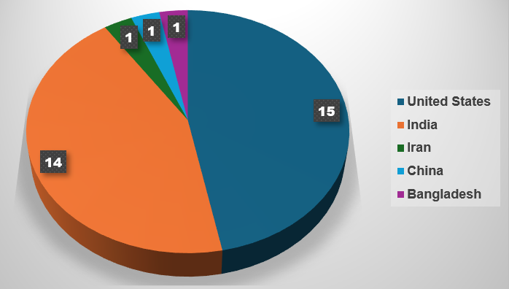
Country

Slide 5
State/Province
North Carolina – 12
Maharashtra – 5
Gujarat – 4
Karnataka – 2
Others - 1 each (total: 9)

Slide 6
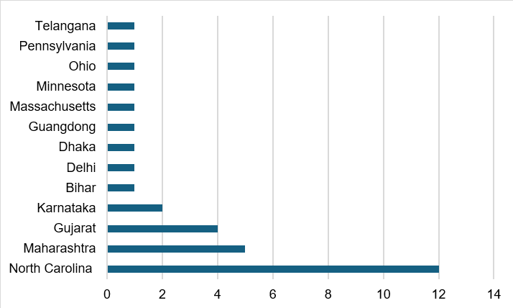
State/Province

Slide 7
Hometown
Ahmedabad – 4
Mumbai – 3
Raleigh, Charlotte – 2 each
Others – 1 each (total: 21)

Slide 8
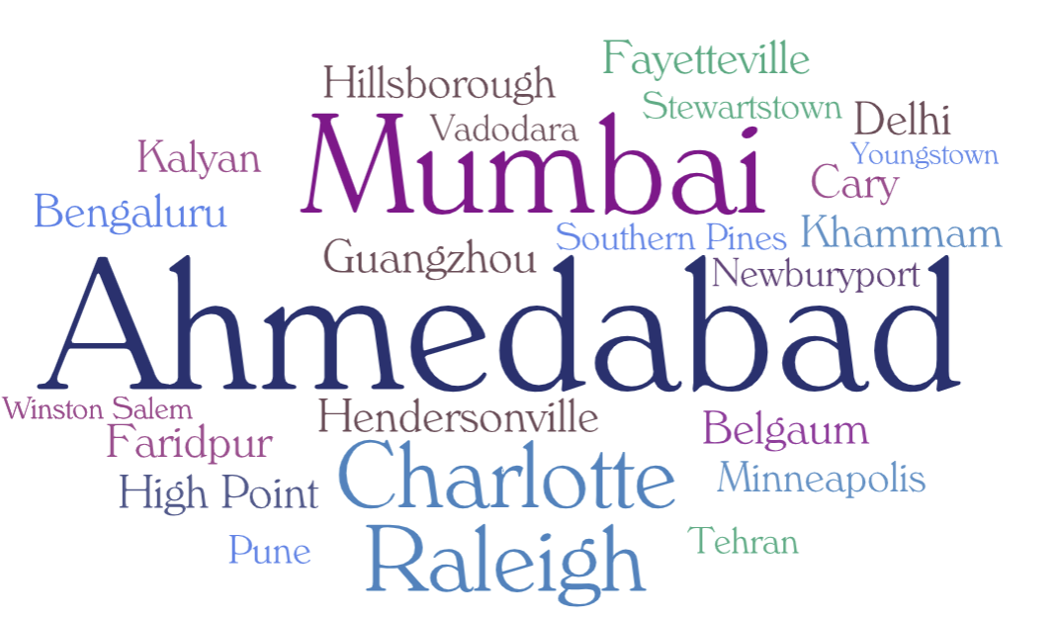
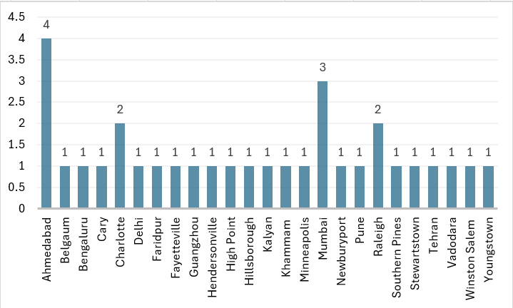
Hometown

Slide 9
Undergraduate School/University
NC State University – 9
Nirma University – 3
University of North Carolina at Charlotte – 2
Others – 1 each (total: 15)

Slide 10
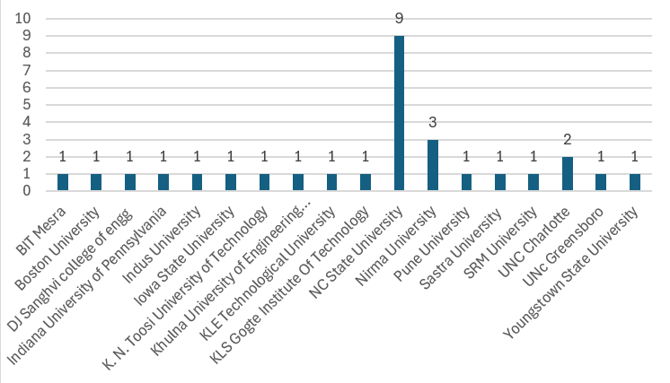
Undergraduate School/University

