Slide 1
CSC/ECE 517 Roster Summary
Spring 2024

Slide 2
Where do we come from?
Country
State/Province
Hometown
Undergraduate school

Slide 3
Country
India – 30
United States – 19
China, Cuba, Ethiopia, South Korea – 1 each

Slide 4
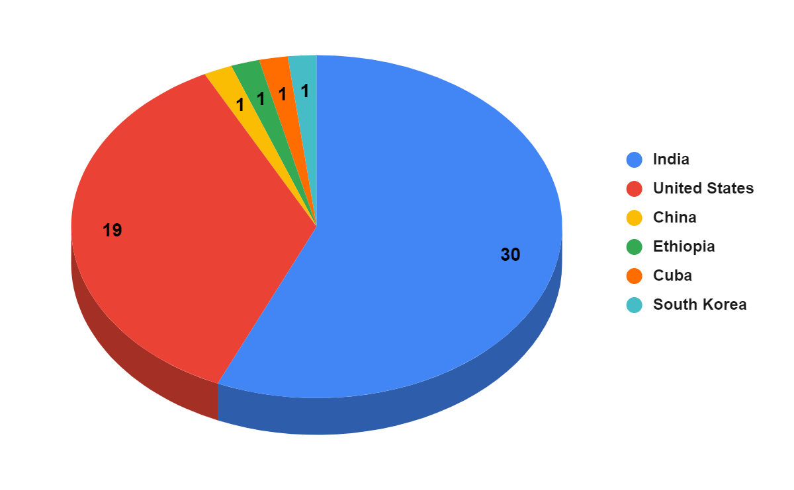
Country

Slide 5
State/Province
North Carolina – 13
Maharashtra – 12
Gujarat – 9
Karnataka, Tamil Nadu – 3 each
Andhra Pradesh, California – 2 each
Others - 1 each (total: 9)

Slide 6
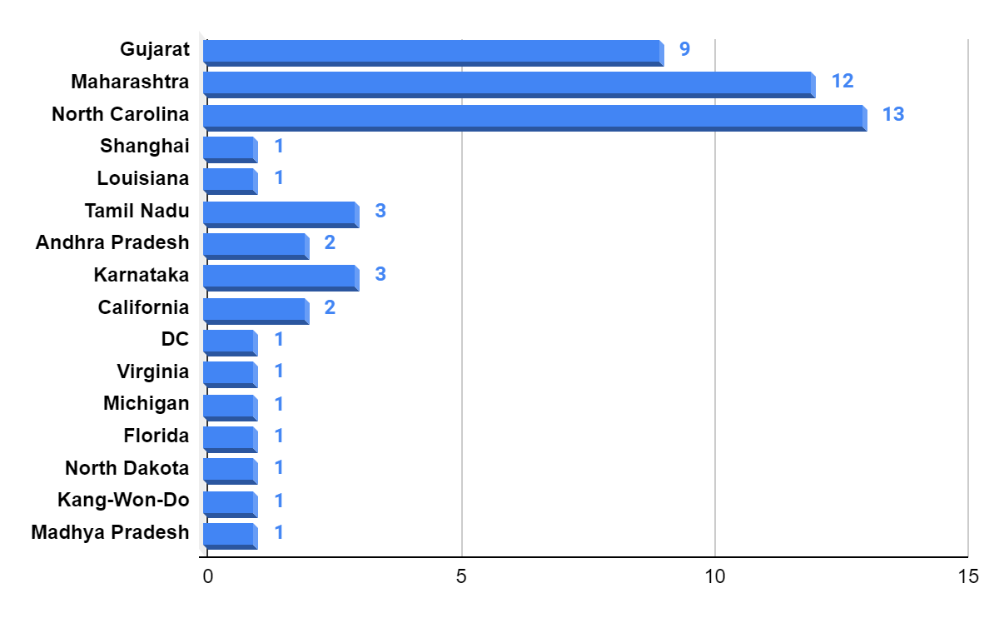
State/Province

Slide 7
Hometown
Mumbai – 9
Ahmedabad – 4
Cary, Chennai, Raleigh – 3 each
Charlotte, Gandhinagar, Morrisville, Pune, Surat, Vijayawada – 2 each
Others – 1 each (total: 19)

Slide 8
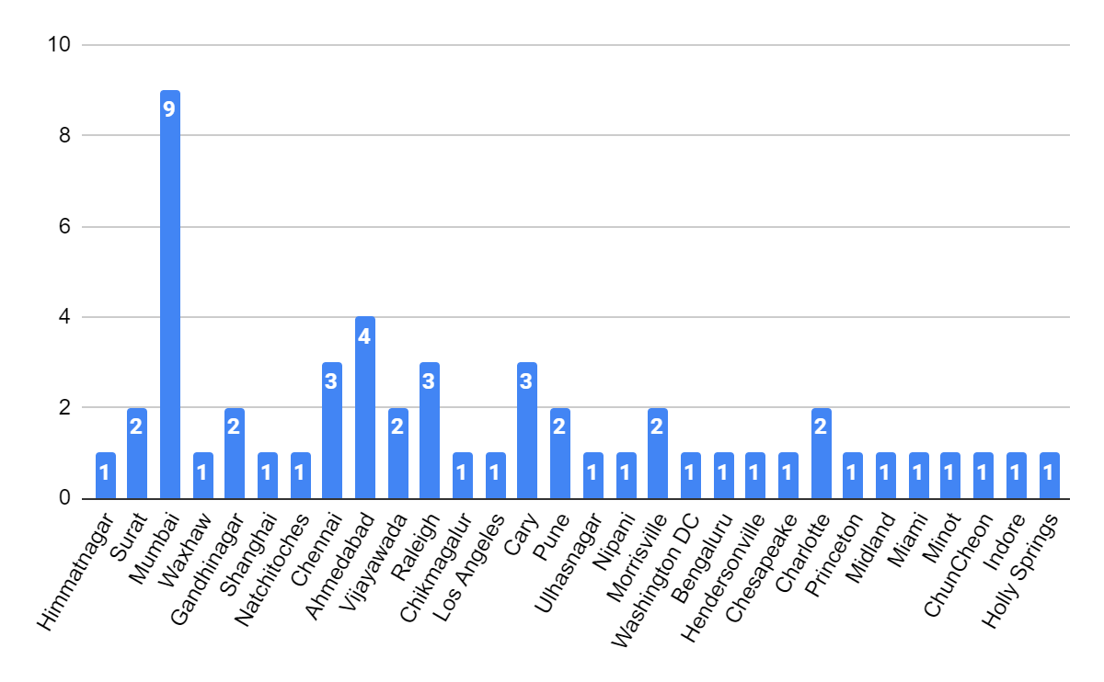
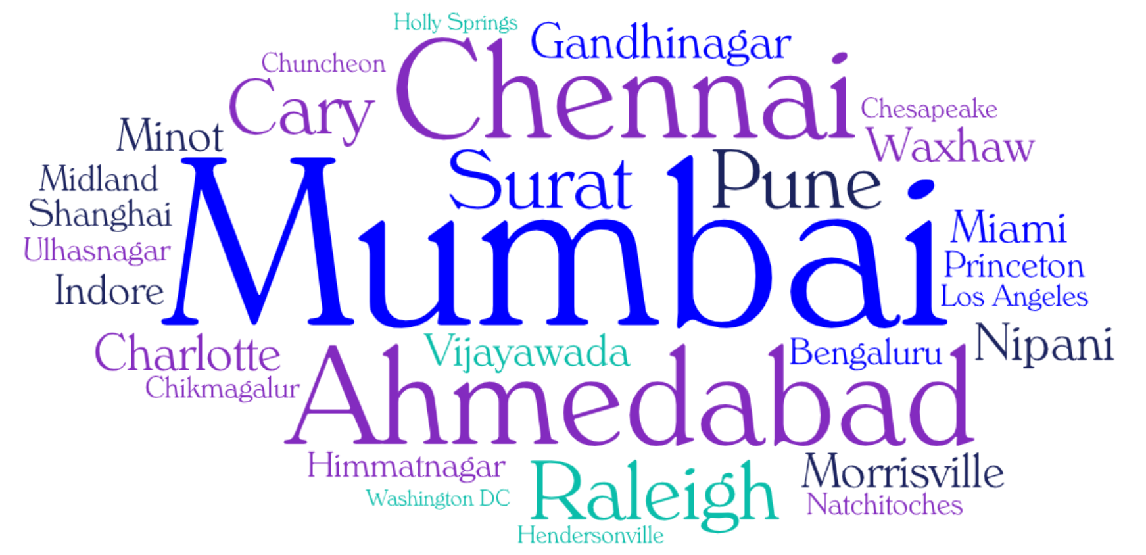
Hometown

Slide 9
Undergraduate School/University
NC State University – 9
Pandit Deendayal Energy University, KJ Somaiya College of Engineering – 5 each
UNC Charlotte, Sardar Patel Institute of Technology – 2 each
Others – 1 each (total: 30)

Slide 10
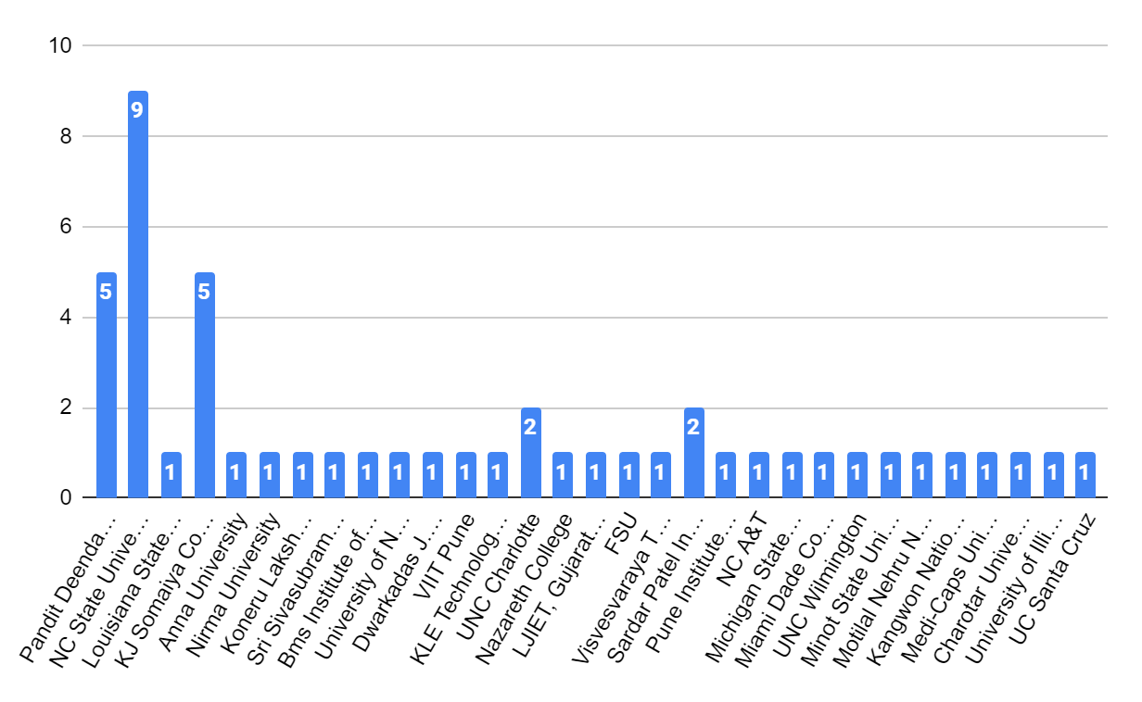
Undergraduate School/University

