Slide 1
CSC/ECE 517 Roster Summary
Spring 2023

Slide 2
Where do we come from?
Country
State/Province
City
University

Slide 3
Top 3 Countries
India – 23
USA – 4
Vietnam – 1

Slide 4
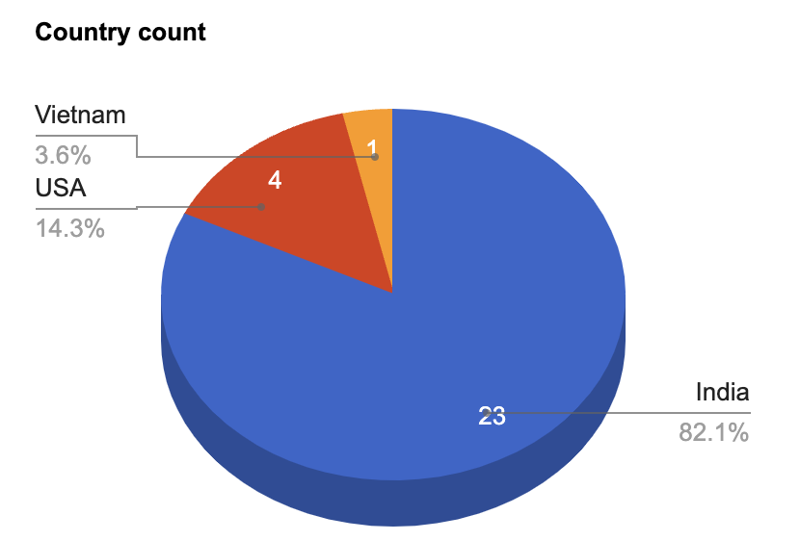
Countries

Slide 5
State/Province
Maharashtra – 12
North Carolina – 8
Gujarat – 2
Karnataka - 3
Telangana – 2
West Bengal – 1
Chhattisgarh – 1

Slide 6
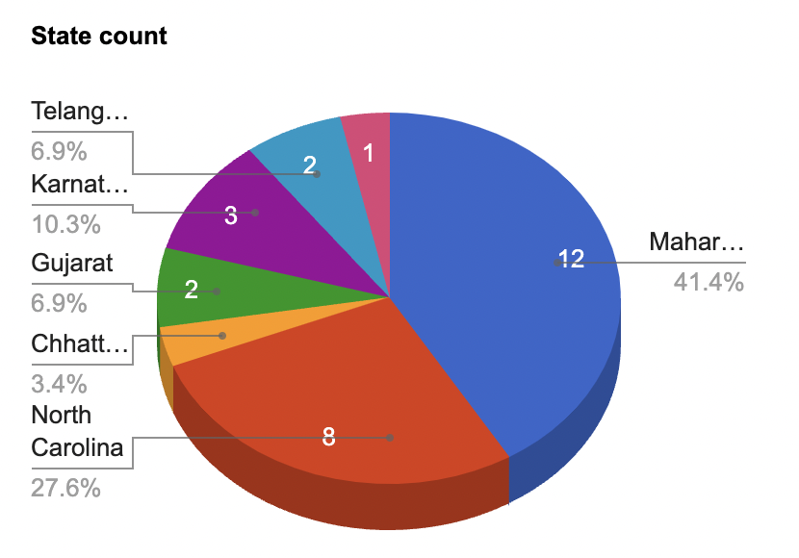
State/Province

Slide 7
Hometown
Mumbai – 8
Pune - 3
Bangalore – 3
Durham – 2
Hyderabad - 2
Others - 1 each

Slide 8
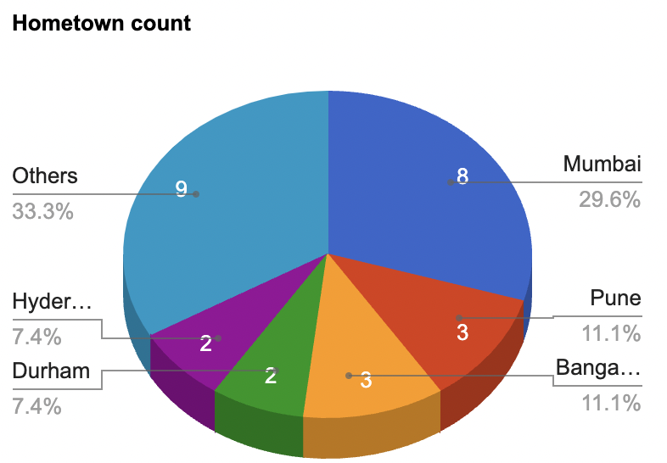
Hometown

Slide 9
Undergrad school/university
NC State University – 5
University of Mumbai – 4
Elon University – 2
Others - 1 each

Slide 10
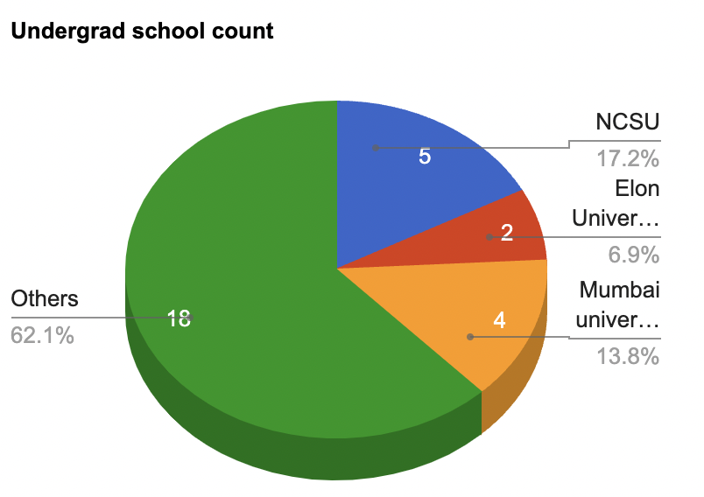
Undergrad school/university

