Slide 1
Version Control in Open-Source Projects
Images from:
https://www.atlassian.com/company/news/press-kit
https://about.gitlab.com/press/press-kit/
https://git-scm.com/downloads/logos
https://github.com/logos

Slide 2
Outline
git and GitHub: Terminology and workflow
Editing and committing changes
Merging
Merging automatically
Handling merge conflicts
Extras
Acknowledgments

Slide 3
Version Control Systems
Version control systems are software tools for:
Maintaining project history
Review
Revert
Facilitating collaboration
master (main) branch / production version
Developers work asynchronously on feature branches
Merge new features into master branch
Notes:
FOSS and more generally all large software projects developed by teams can be complicated to manage.
They are helpful in reviewing because it is easy to determine who made the changes. They also facilitate code reviews.

Slide 4
git and GitHub
Tools for version control and collaboration:
git
CLI version control tool that runs on your computer
maintains repositories (repos)
complete copy of the code / docs
complete history of changes
Can also be integrated into IDE or GUI tools.
gitHub
a cloud service for hosting repositories
facilitates collaboration
Forking/Upstreaming support
Issue tracker
2. Tools for Version Control
Notes:
Git and GitHub are currently the dominant tools for supporting version control and collaboration in software development.
These two tools work together.
[CLI = command-line interface]
Very broadly:
- Individual developers use git
- to manage their repositories and track code changes.
- Communities use GitHub
- to bring together changes from developers
- to track and communicate needs (e.g., with issue tracker)
The line between the two can become a little blurry.
- GitHub also lets you do some things that are really git operations.

Slide 5
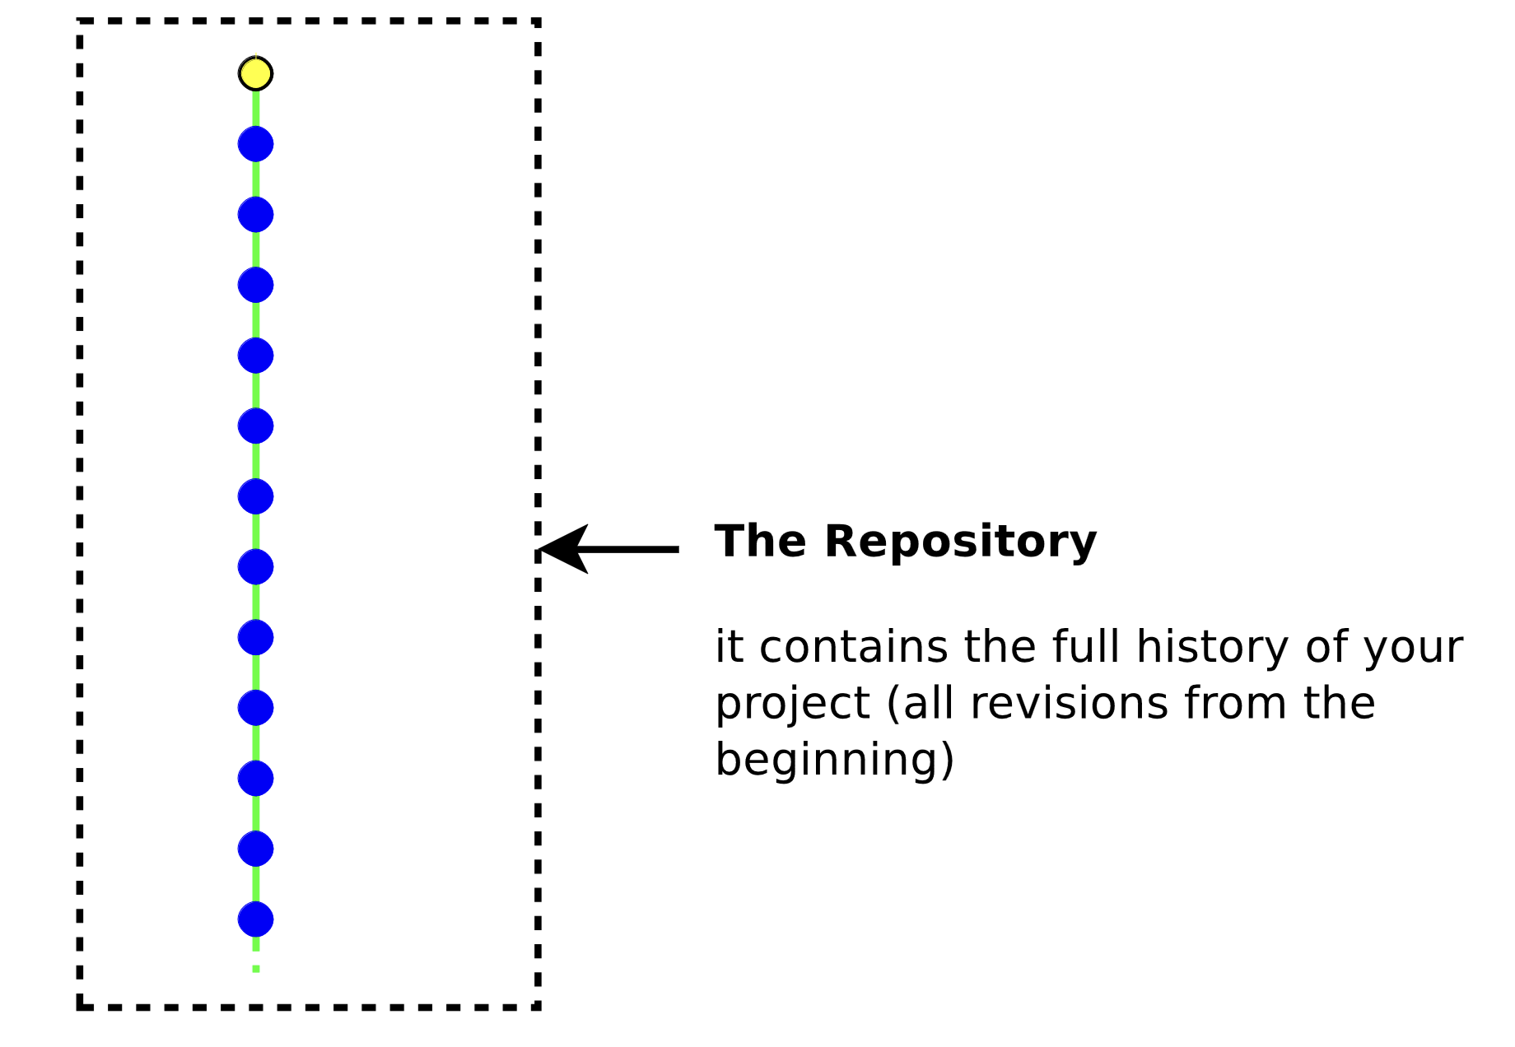
git: Simple use case: Maintaining commit history
Source: https://people.irisa.fr/Anthony.Baire/git/git-for-beginners-handout.pdf
3.4 Git Terminology: Commit history
Notes:
To understand how version control (e.g. git) tracks changes and keeps a history
We need to know about commits and commit history.
A commit describes a set to changes.
- includes the changes
- who made the changes,
- when the changes were made
- a description of the changes and their purpose
- a unique id for the commit.
You can think of this sort of like track changes in Word or Google Docs if you have used that.
It is this sequence of commits that documents the history of the project.
- Another way to think of it is that you could start from an empty project
- then go along and apply each commit in order
- when you have applied all of the commits you have the current state of the project.
TIP: Even though it is not quite accurate, it is often useful to just think of every commit as its own full copy of the files at that point in time.
- Because each commit has a unique identifier, then we can think about resetting the project to any commit as reverting to that point in time.
- Useful for
- understanding changes
- undoing undesirable changes

Slide 6
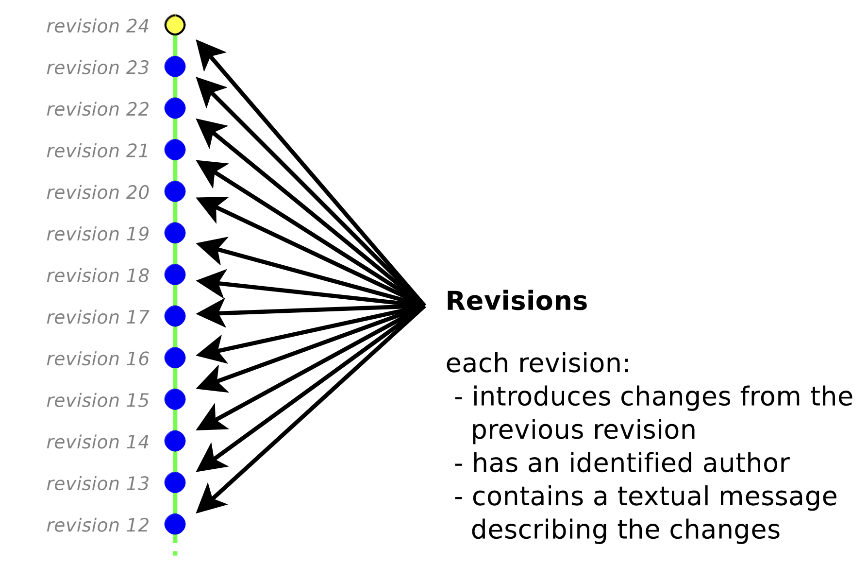
git: Commits/revisions
Source: https://people.irisa.fr/Anthony.Baire/git/git-for-beginners-handout.pdf
3.4 Git Terminology: Branches and Commits

Slide 7
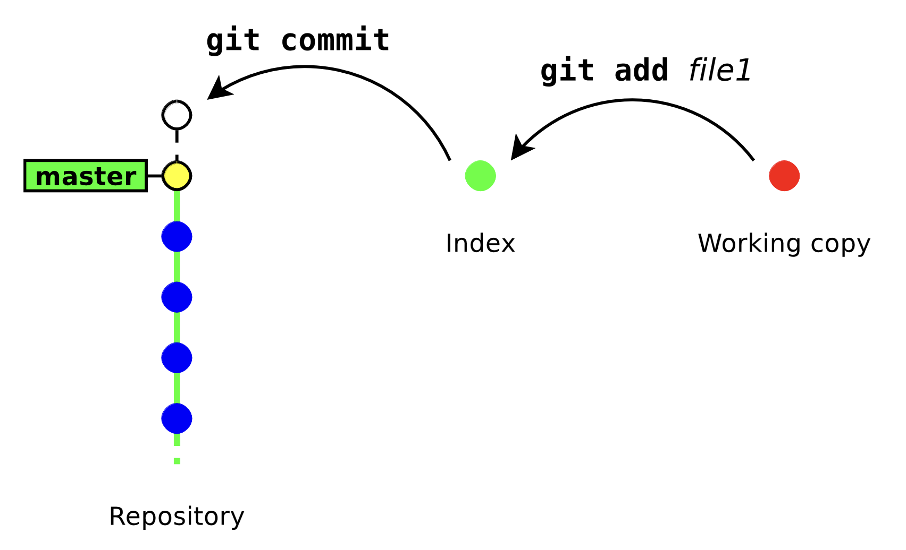
git: Making changes to a repository
Staging
Source: https://people.irisa.fr/Anthony.Baire/git/git-for-beginners-handout.pdf
3.4 Git Terminology: Branches and Commits
Notes:
When you make changes to a file, you execute ‘git add file1’ to add those changes to the staging area.
From there you execute git commit to finalize those changes and add them to git’s history tree.

Slide 8
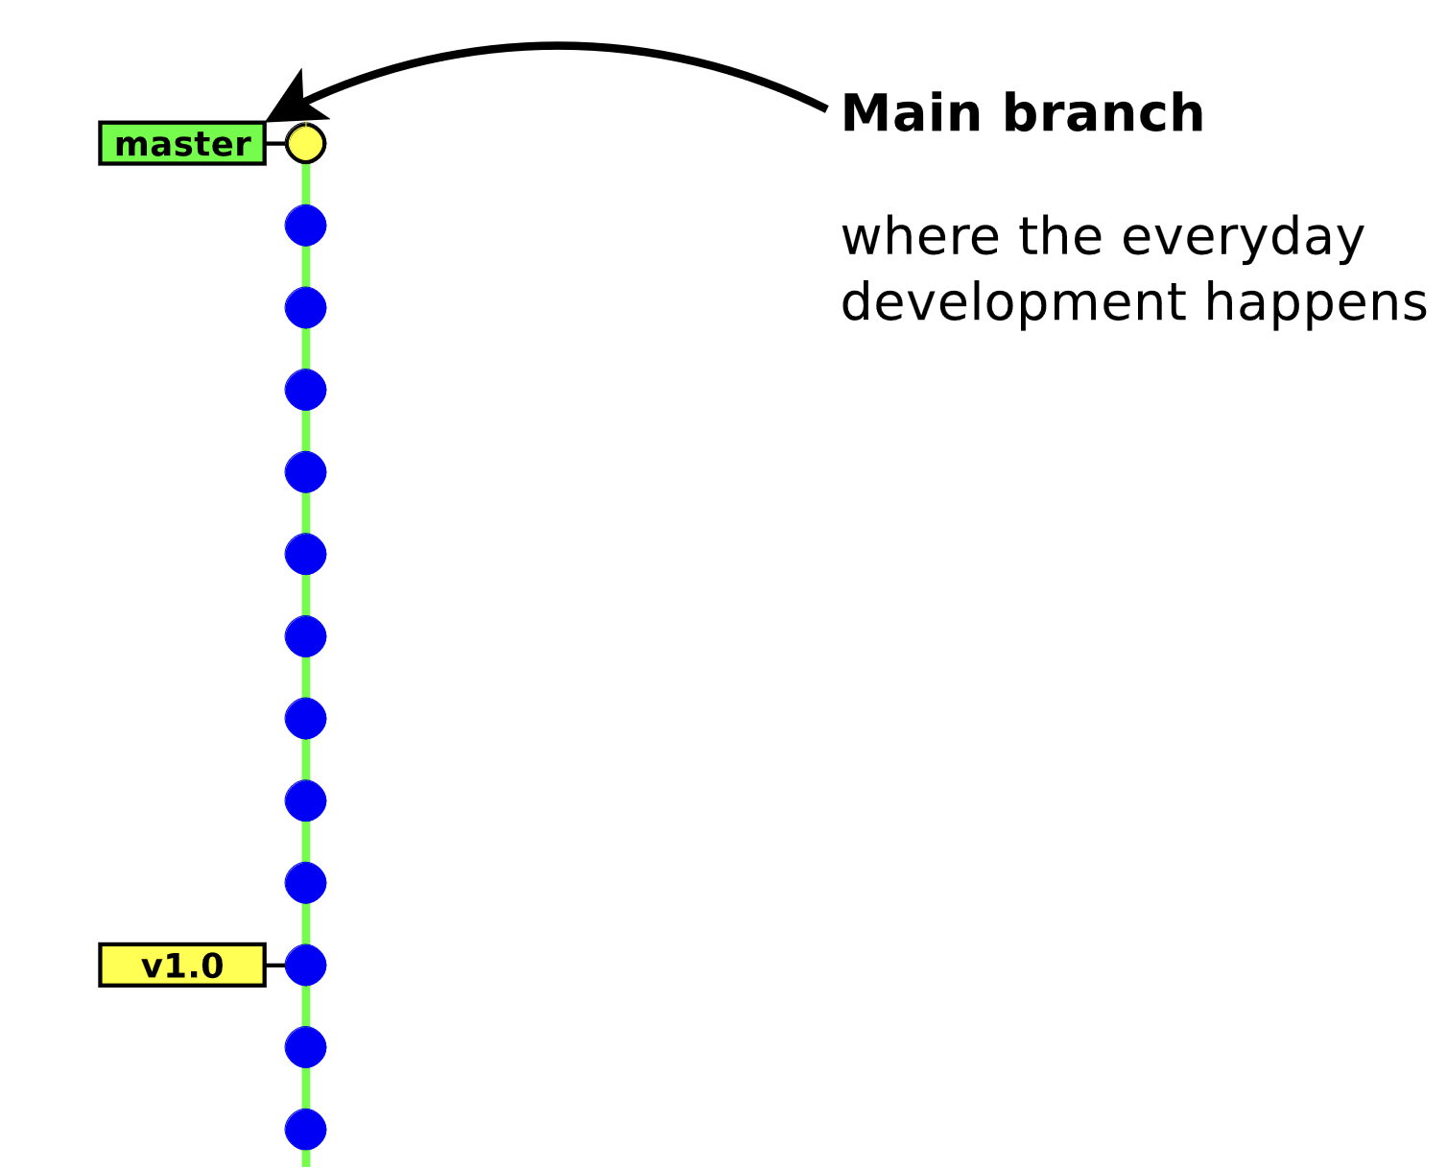
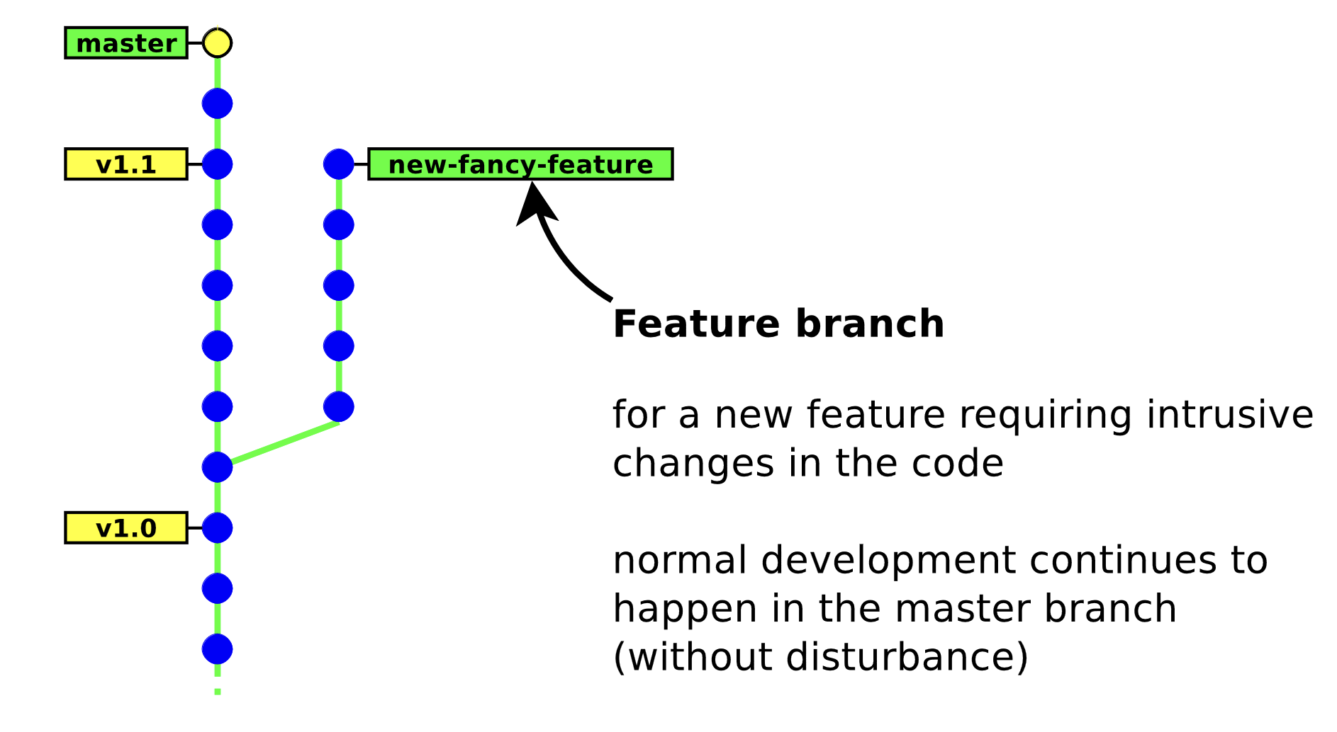
git: Main and Feature Branches
Source: https://people.irisa.fr/Anthony.Baire/git/git-for-beginners-handout.pdf
3.4 Git Terminology: Branches and Commits
Notes:
Repositories will usually have multiple branches.
One branch in the upstream project will be designated as the point from which new work should begin
- This branch is often called the main branch.
- there is nothing special about the name – it is just a convention.
- different projects will do it differently.
When you want to do some work (e.g. add a feature, fix a bug, etc)
- you create a new branch
- the new branch is like a full copy of the repository.
- you then add commits for the work you want to do to the new branch.
- these branches on which you do work are generically called feature branches.
- but you will give them specific names that are descriptive of what they do.
- e.g. newColorScheme – to develop a new color scheme for the user interface.

Slide 9
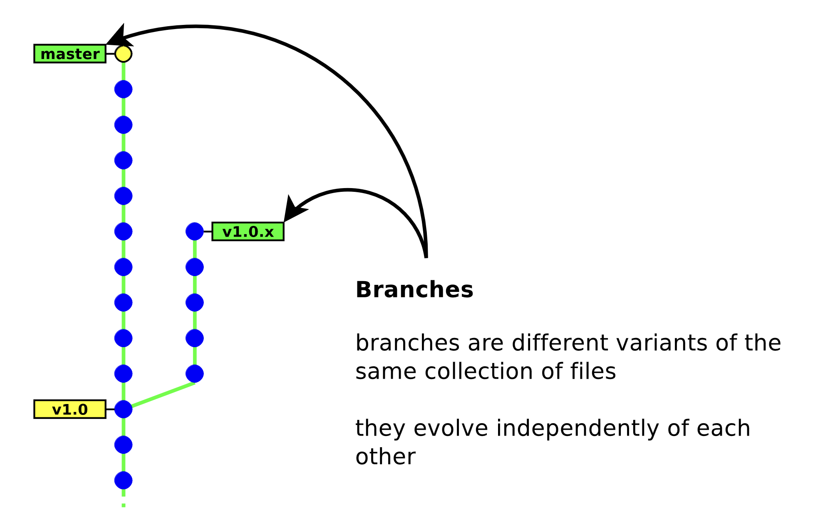
git: Branches and Revisions
Source: https://people.irisa.fr/Anthony.Baire/git/git-for-beginners-handout.pdf
3.4 Git Terminology: Branches and Commits
Notes:
You may be working on multiple different tasks at the same time.
- When doing so you can have multiple feature branches simultaneously.
- e.g. stop working on the new color scheme to fix a null pointer exception that was discovered.
- You can even make a branch of a branch.
- e.g. started working on the new color scheme
- but after a while decided you wanted to try it a different way.
- instead of deleting what you’ve done
- you can go back and create a new branch from any commit and try something different.
- that way if you later decide the first way actually was better you can jump right back to it.
- You can switch back and forth between branches to
- work on different tasks
- to try different approaches
RULE: You should only ever make commits to feature branches.
- Only project maintainers will change the main branch.
- We’ll see that this happens via the pull requests that we’ve mentioned.
- we’ll see how that works in a bit…
- but basically if they accept your changes
- then they will merge them into to the main branch

Slide 10
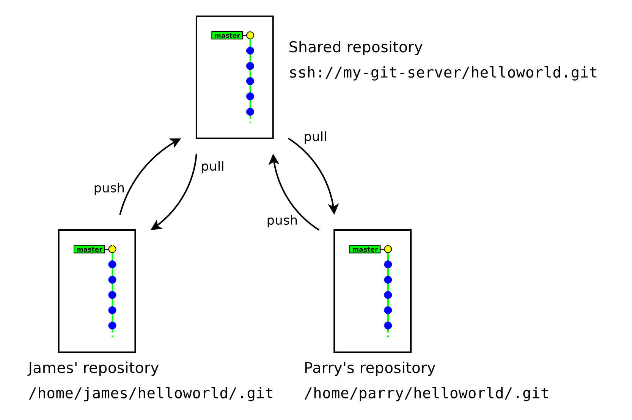
git and GitHub: Local vs. Remote (shared)
Source: https://people.irisa.fr/Anthony.Baire/git/git-for-beginners-handout.pdf
3.1 Git Terminology: Setting up a Repository
Notes:
Local - things that are on your machine
- saved on your hard disk
- can be used without access to a network
- you will interact with them using your tools
- editor, shell, git, etc.
Remote: things that are in the cloud
- Stored on servers in data centers somewhere out on the Internet
- E.g. at GitHub or GitLab, etc…
- You will interact with them through your browser.

Slide 11
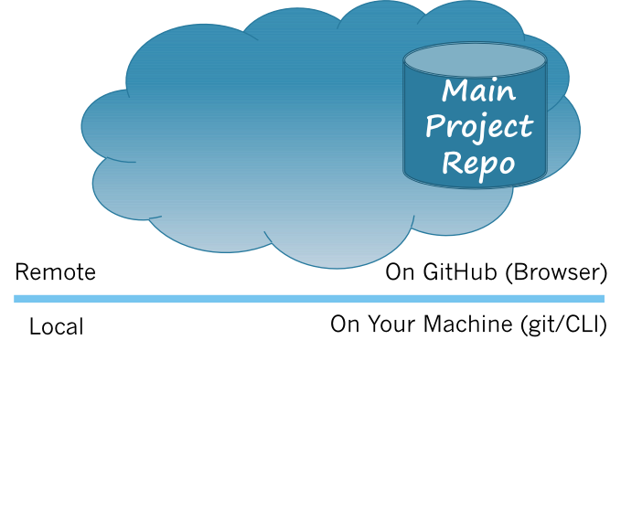
GitHub and git: The Upstream
The
Upstream
Repository
3.1 Git Terminology: Setting up a Repository
Notes:
When you work on an OSS project:
- The project code will typically live on one of the repository hosting services (e.g., GitHub)
- The repository on GitHub is called the upstream repository
ASK: Why does it live on a hosting service?
- Collaboration, transparency, release early & often
ASK: Will you have write permissions to the upstream?
- Nope, at least not until you gain trust and move up to a maintainer role.
- This is going to be an important factor is understanding why GitHub/git work the way that they do.

Slide 12
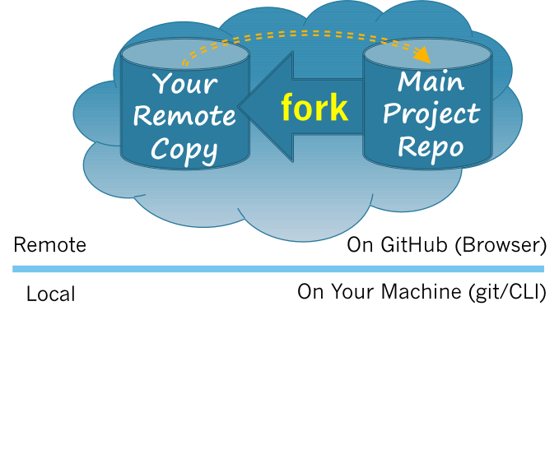
GitHub and git: Forking the Upstream
The
Upstream
Repository
3.1 Git Terminology: Setting up a Repository
Notes:
The first step in working with the project is to Fork the Upstream.
- I.e. When you Fork the Upstream, you make your own copy of the main project repo into your GitHub space.
ASK: Why would you need to make a copy?
- To make changes you need write permissions.
- You have full control over this copy.
ASK: How many forks will there be?
- At least as many as there are developers
This fork:
- is an exact copy of the upstream (main project) repository
- knows where the upstream is from which it was forked.
- This is represented by the orange arrow from your remote copy to the upstream.
- We will soon see that this is what makes it possible to upstream the changes.
- You have full write permission to the contents of this fork.

Slide 13
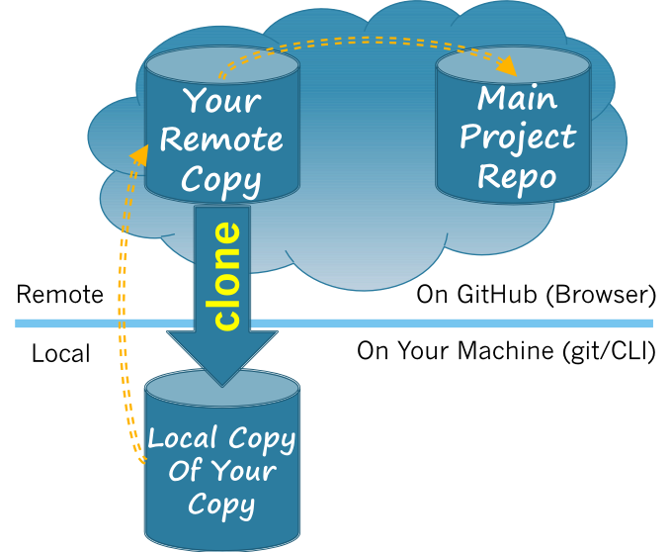
GitHub and git: Cloning your Origin
The
Upstream
Repository
Your
Origin
Repository
Your
Local
Repository
3.1 Git Terminology: Setting up Repository
Notes:
The next step is to Clone your fork.
- When you clone your fork, you make another copy of the repository on your local machine.
- That copy is called your Local repository.
- It is on your local machine, stored on your disk drive.
- The fork from which your local repo is cloned is called your origin repository.
- It is the ”origin” of your local repo.
ASK: Why do this?
- Can open files with your editor
- Can compile and run the code
- Can work without network access (crazy!)
- You also have full write access to this copy.
Note that the local clone knows the origin from which it was cloned.
- i.e. it knows where it came from.
- This is represented by the orange arrow from the local repo to the origin repo.
ASK: Why should it know that?
- It is how we will be able to upstream changes!

Slide 14
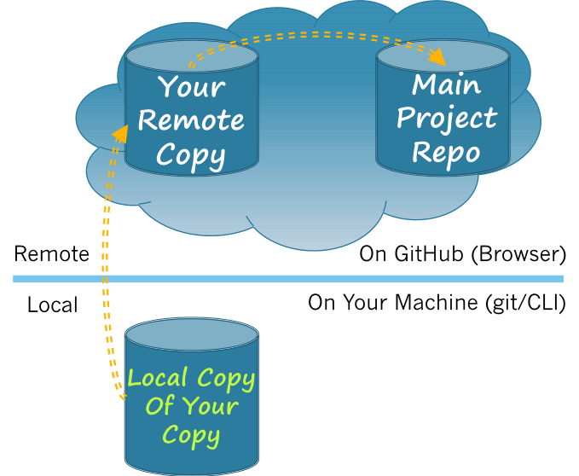
Workflow: Make Changes*
Simplified
for now
3.2 Git Terminology: Making Changes
Notes:
A developer working on the code will be editing in their local repo.
- They basically open up a code file in their editor, make some changes, save the file.
- This is represented by the change of the words from white to green
- It is just a simple way to indicate that some changes to the code.

Slide 15
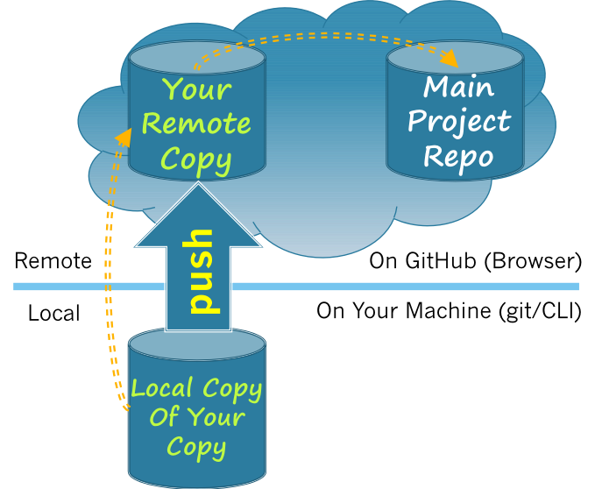
Workflow: Push to Origin
3.3 Git Terminology: Pushing Changes
Notes:
Now that you have changes that you like…
Maybe you want to upstream them to give them back to the project.
To do that you’ll need to get them to the cloud
- So you will need to move those changes to your remote repo – i.e. to your origin
- and eventually move them to the main repo also – the upstream.
The first step is to push the changes to your origin.
- The change to green in the origin reflects your local changes being copied there.
ASK: Why do you think we push to the origin?
- Most importantly, you are not allowed to write to the upstream repo.
- remember only maintainers are allowed to do that.
- The upstream repo cannot see your local copy because it is on your machine.
- You might erase them, or turn your machine off, or move it to some other location…
- So pushing puts your changes into the hosting service
- Then the upstream will be able to find them – once you tell the upstream that they exist!

Slide 16
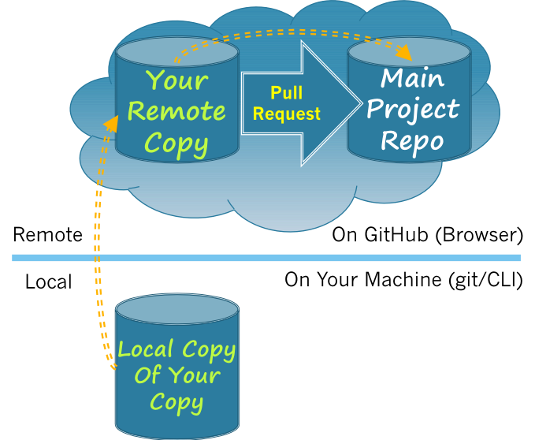
Workflow: Making a Pull Request
3.3 Git Terminology: Pushing Changes
Notes:
Now your changes are in the hosting service
- So now you need to tell the maintainers at the upstream that you have some changes you’d like to contribute.
- You do that by making a Pull request.
- The pull request is essentially a message to the upstream maintainers
- The pull request tells them about the changes you want to contribute.
- The maintainers and the upstream repo can see your changes because the changes are in your remote, which is in the cloud.

Slide 17
Workflow: Merge into Upstream
3.3 Git Terminology: Pushing Changes
Notes:
If the project maintainers/leaders like the changes you proposed in your Pull Request
- they can merge your proposed changes into the upstream.
Example of a recipe:
- Aunt Maria wants to add chocolate chips. —> approved
- Uncle Miles wants to add nuts.
- That is they combine your code with the code in the main repo
- e.g. Aunt May’s recipe now contains chocolate chips.

Slide 18
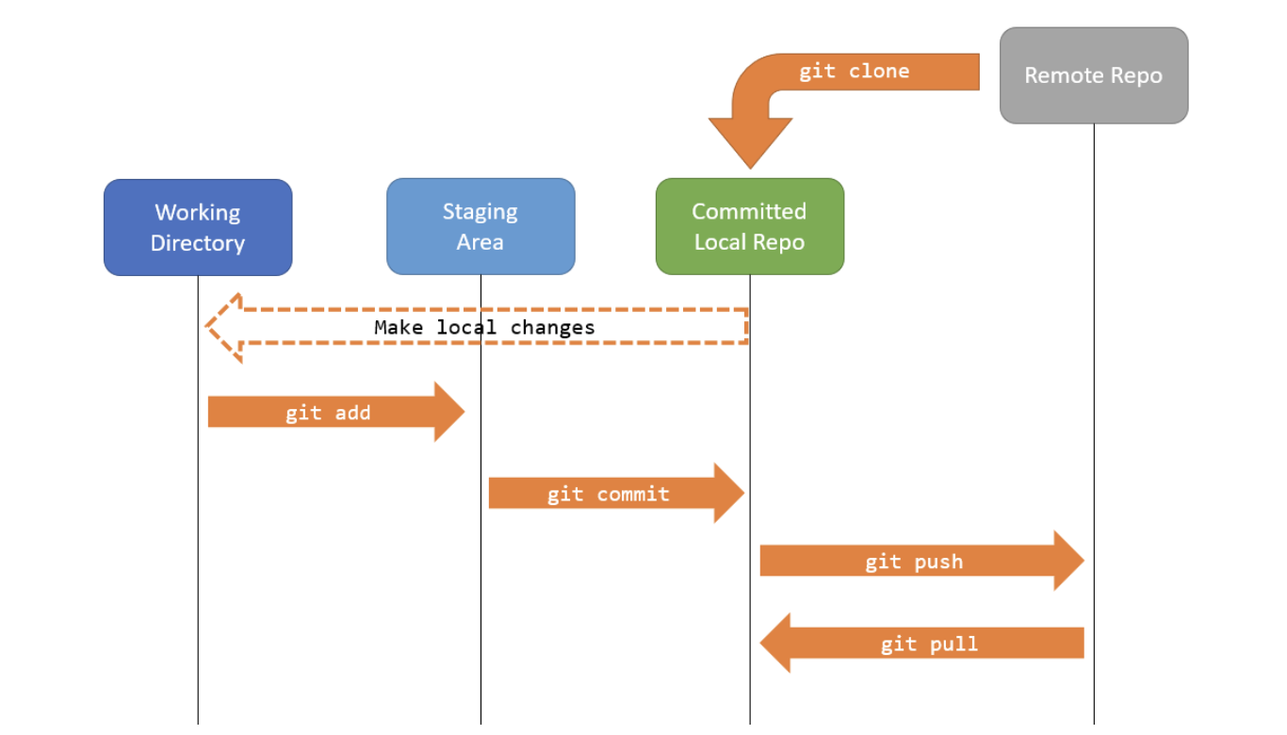
Overall Workflow
Source: https://people.irisa.fr/Anthony.Baire/git/git-for-beginners-handout.pdf
3.4 Git Terminology: Branches and Commits
Notes:
A simplified version of the overall workflow. We can start with this and expand each of the components involved with more detail.

Slide 19
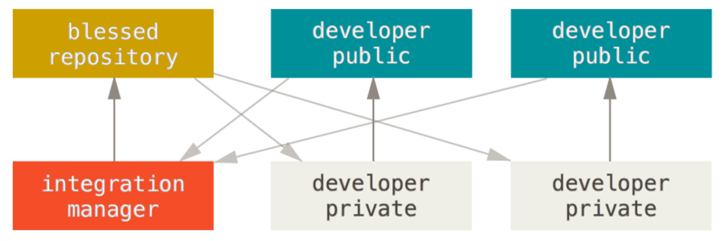
Integration-manager workflow

Slide 20
Outline
git and GitHub: Terminology and workflow
Editing and committing changes
Merging
Merging automatically
Handling merge conflicts
Extras
Acknowledgments

Slide 21
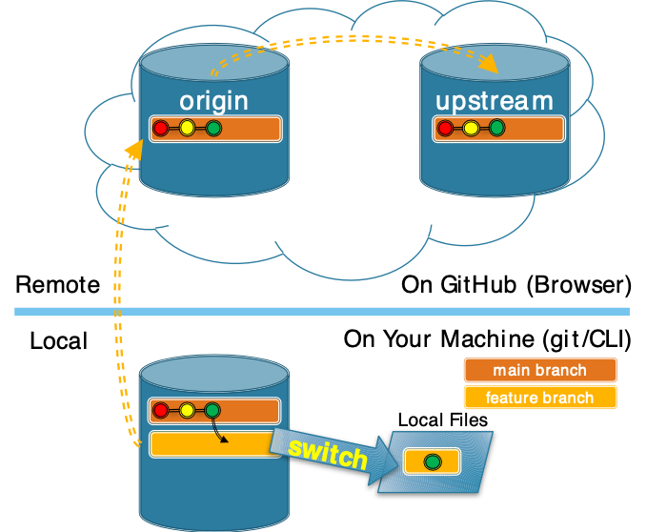
git: Switch to Feature Branch
Switching to a feature branch makes it the “Active Branch” and the target for new commits.
(git checkout feature)
3.4 Git Terminology: Branches and Commits
Notes:
To develop a new feature, you would typically create a new “feature” branch.
Before you can commit any changes to this branch you need to tell git that you want to use it.
This is called switching to a feature branch.
- Switching to a feature branch makes it the target for future commits.
But notice:
- the Local Files are still green
- They still match the last commit from main here.
- This is because we have not yet changed them.

Slide 22
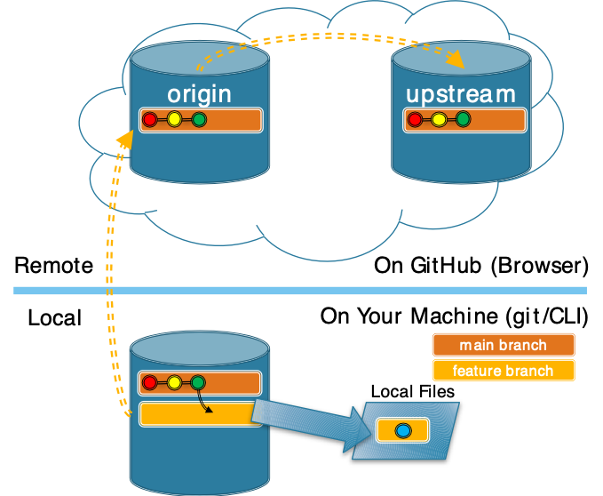
Local Files: Edit Local Files
3.4 Git Terminology: Branches and Commits
Notes:
Now when you edit your local files
- they will be become different from the last commit
- here they are colored blue to indicate a set of changes.
- note that the commit in the main branch from which they were copied didn’t change
- it is still green.
- It is part of the project history.

Slide 23
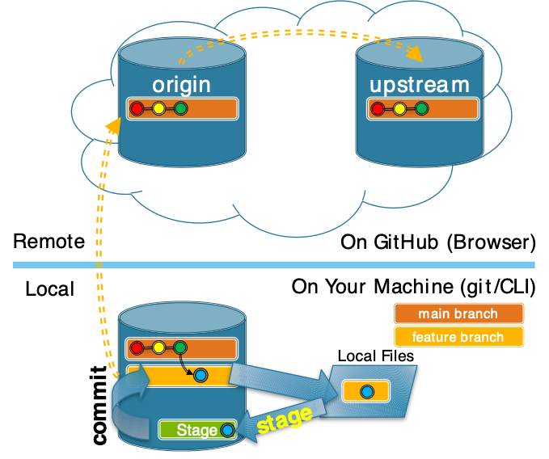
git: Stage Changes and Commit
ProTip: Each commit should contain a nameable unit of work.
3.4 Git Terminology: Branches and Commits
Notes:
When you have completed some work
- You need to commit it to the feature branch.
Committing a set of changes to a feature branch is a two-step process:
- First you add the files that you have changed to the Staging Area using the stage command.
- The set of blue changes is on the stage.
- Then you commit those changes to the feature branch.
- The set of blue changes is added to the feature branch.
Why two steps?
- It may take a number of logical changes to implement a feature
- You could do it all in one big commit.
- But better to stage and commit smaller changes
- That way each change has it own record in the project history.
- For example:
- Maybe you write some code to do something (one commit)
- Then you write code to test it (another commit)
- Or:
- There are multiple parts to implementing a feature
- added the text field for name (commit)
- added a dropdown for class year (commit)
- added a button for submit (commit)

Slide 24
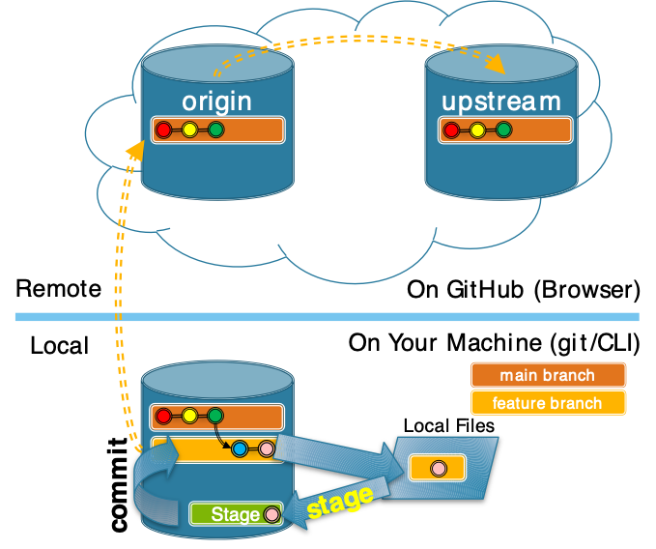
git: Edit/Add/Commit Cycle
ProTip: If It takes multiple nameable units of work to complete a feature or bug fix. Give each its own commit.
3.4 Git Terminology: Branches and Commits
Notes:
You can repeat the edit, stage, commit cycle as many times as is necessary.
Try not to think of a commit as a save.
- When you save, it changes local files.
- You should do that constantly!
- Make a commit when you have completed a nameable unit of work.
- I.e. when you complete some cohesive sub-task.
- E.g. adding a text field, writing a test, etc…
- This ensures that you will be able to give every commit a meaningful message
- If you can’t think of a short description of what you’ve done, maybe its not a commit.
You can commit a single file, or all files that have been staged.

Slide 25
Exercise
Test your knowledge of Git commands.
3.4 Git Terminology: Branches and Commits
Notes:
Local - things that are on your machine
- saved on your hard disk
- can be used without access to a network
- you will interact with them using your tools
- editor
- browser
- shell
- git
- etc
Remote: things that are in the cloud
- Stored on servers in data centers somewhere out on the internet
- E.g. at GitHub or GitLab, etc…
- You will interact with them through your browser.

Slide 26
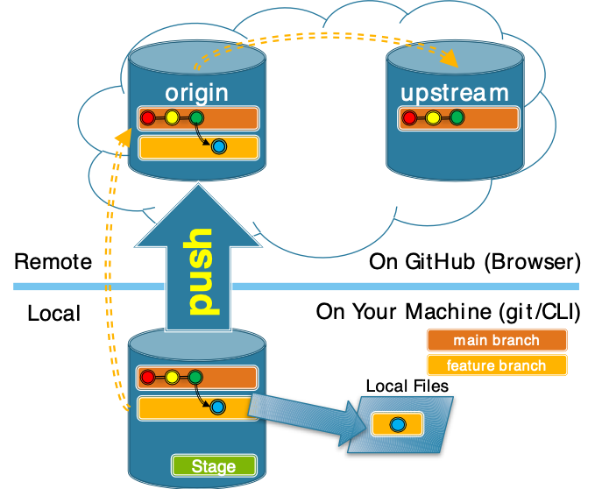
GitHub and git: Push Branch to Origin
Notes:
Now in order to upstream
- you need to get your changes into the cloud.
- that way you can ask the upstream maintainers to consider them.
To do that
- you push your branch to your origin.
- this makes a copy of your branch and any commits it contains to your GitHub space.

Slide 27
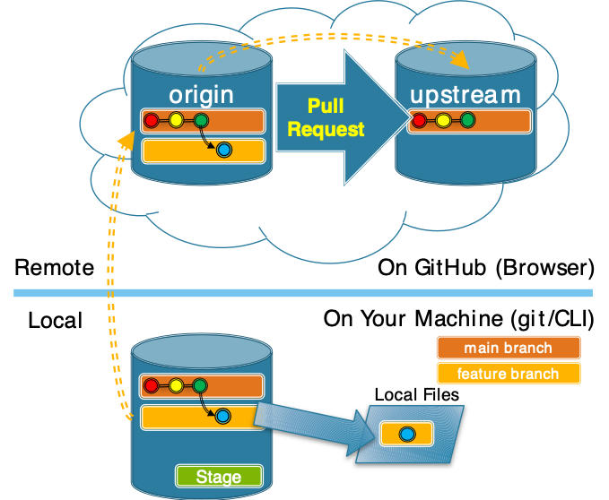
GitHub: Make Pull Request
A Pull Request asks the maintainers to consider merging your changes into the main branch.
Notes:
Already talked about on slide 15
Once your branch is in the cloud (I.e. on GitHub)
- you can notify the upstream of your changes
- ask them to consider merging them into main branch.
- This is called a Pull Request
This is the point to which you will get in the associated activity.
You will:
- Make and switch to a feature branch
- Fix the issue that you claimed.
- Stage the changes that you make.
- Commit your changes to your feature branch
- Push that feature branch to your origin
- Make a pull request for it.
Then next time we will see:
- what PRs look like to the upstream maintainers
- how your changes get into the main branch
- what you have to do after that to keep working on the project.

Slide 28
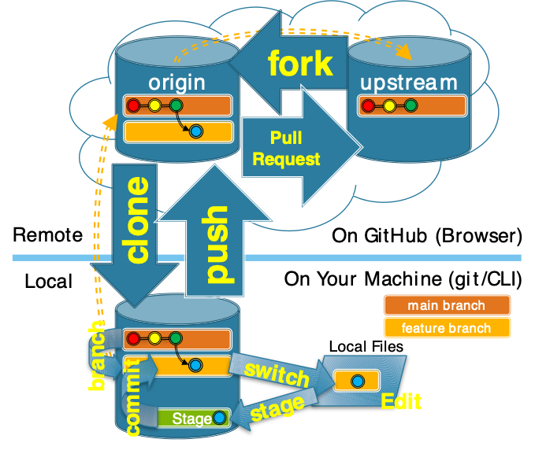
GitHub and Git: Upstreaming
1. Fork the Upstream
2. clone your Origin
3. Create feature branch**
4. switch to feature branch**
5. Edit local files*
6. stage changes*
7. commit to feature branch*
8. push to your origin** ***
9. Make a Pull Request**
* Loop for each nameable change.
** Repeat for distinct contributions.
*** Repeat to update PR.
Notes:
This is just here as a reference.
- Should be representative of what is created through discussion of the activity.
1,2 – typically only once for a given project.
3 – can make multiple branches if working on different things
4 – can switch back and forth between multiple branches
5,6,7 – are a loop.
- once around for each nameable unit of change.
- each with a meaningful commit message.
8 – can push
- different feature branches if working on multiple contributions.
- the same feature branch with new changes
- Forgot something / Manager requests
- Resolve merge conflicts
- will automatically update PR
- you will see this in effect at the start of next week’s class.
9 – Typically only once for a given change
- But may have multiple for different contributions.

Slide 29
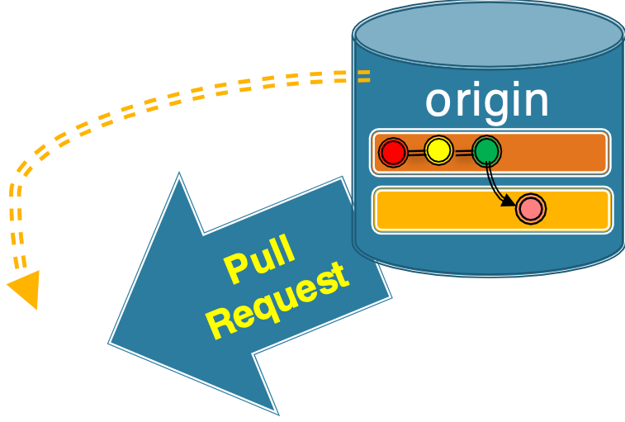
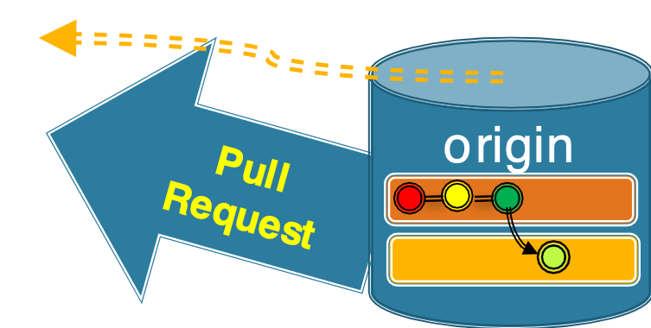
GitHub: Pull Requests to Upstream
Demo: Merging Pull Requests into the Upstream.
Editing and committing changes
Notes:
The current state:
- You have made a PR to the upstream for your changes
- The blue commit.
But keep in mind that your classmates have also made PR’s for their changes
- pink commit
- lime commit
This is like a FOSS community working asynchronously across the globe.
Demo:
- As a project maintainer.
- Show list of PR’s in the upstream
- Show one and see
- “This branch has no conflicts with the base branch”
- “Merging can be performed automatically.”
- Because issues were chosen very carefully
- None of them changed the same parts of the code.
- NOTE: All PRs should show this.
- Issues were created to be non-conflicting.
- If someone messes up and makes a conflict
- Explain briefly that it is an example of what we will get to.
- Skip it.
- Merge one automatic merge from your section.
- Show that PR is then closed.
- Show that with “Closes” or “Fixes” line that the issue is also closed.
- Show that the PR is displayed in the “Code” pane.
- Show that the link in the “Code” pane take you to the full PR.
- Show diff
- Show ”Commits Pane”
- Show can go to the repo at the time of the commit
- Point out the SHA – unique identifier.
- Merge all of the automatic merges from your section.
- If any have conflicts added by earlier commits.
- Discuss what happened.
- Skip them as that’s what we’ll learn to deal with later today and next time.

Slide 30
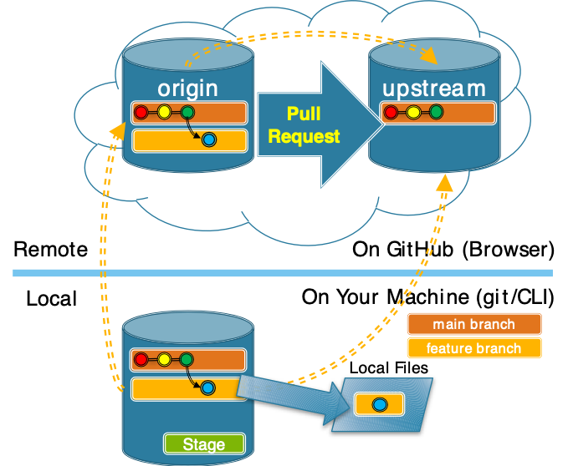
Our Current State
How did we
get here?
commit
Pull Request
Sync
switch
branch
push
stage
Edit
3.5 Git Terminology: Merge Conflicts
Notes:
How did we get here?
- Discuss with your neighbors…
- Place this list of terms [click] into a plausible order.
Build the list on the board:
1. sync
2. branch
3. switch
4. edit
5. stage
6. commit
7. push
8. pull request
Note that all developers might be doing the same thing.

Slide 31
Our Current State
Demo: Look at the Pull Requests on GitHub
3.5 Git Terminology: Merge Conflicts
Notes:
This is where you were when you made your PR.
- When you finish your Github Project homework your PR should say,
- can be merged automatically.
- From this picture that should make sense
- your blue commit (and the fuchsia and lime ones too)
- all can be applied directly on the green one
- which is still at the head of the main branch.
But if we look at your PR’s now…
- They will say “This branch has conflicts that must be resolved”
- Show a few of their PR’s from the upstream repo to illustrate this.
Why/How did that happen?
- next slide.

Slide 32
Upstream Changes
✓
Why could there be a conflict
now?
3.5 Git Terminology: Merge Conflicts
Notes:
This is the state of the world now…
- What has happened? [click]
- Maintainers (me) merged a pull request into main
- the fuchsia commit was added.
[click] Ask: Why do you think it created conflict?
- Just get at the idea that the blue (or lime) commit
- must have changed the same parts of the repo
- i.e. the same area of a file.
- Don’t need to be too precise here.
Truth:
- I merged a commit that changed
- all four lines that were affected by the round 2 issues.
- so that commit will create a merge conflict for everyone

Slide 33
Outline
git and GitHub: Terminology and workflow
Editing and committing changes
Merging
Merging automatically
Handling merge conflicts
Extras
Acknowledgments

Slide 34
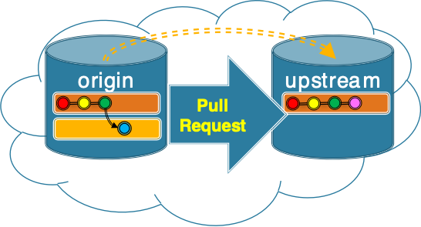
A Merge Commit
A merge commit
add changes from
one branch into
another branch.
Time
main
featureBranch
3.5 Git Terminology: Merge Conflicts
Notes:
When two branches are merged
- A merge commit is added to the target branch
- In this case we are showing an automatic merge of a feature branch into the main branch.
- Again, this is what the maintainers will do when your branch has no conflicts.
- Is what happened with your “Round1” issues when they were merged in the previous activity.
Having a merge commit makes it clear where the changes came from.
- part of the history.
- preserves the fact that a branch was merged
- where the branch came from
- what commits it contained
- when it was merged
- who merged it.

Slide 35
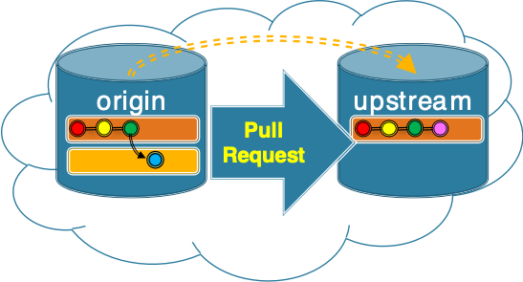
Merging Branches: Common Ancestors
The Best Common Ancestor
is often the most recent common ancestor
A Common Ancestor is a commit that exists in both branches.
Old MacDonald had a farm
And on that farm, he had a pig
With an oink oink here
And an oink oink there
Old MacDonald had a farm
And on that farm, he had a duck
With a quack quack here
And a quack quack there
Old MacDonald had a farm
And on that farm, he had a cow
With a moo moo here
And a moo moo there
Old MacDonald had a farm
And on that farm, he had a duck
With a quack quack here
And a quack quack there
Old MacDonald had a farm
And on that farm, he had a cow
With a moo moo here
And a moo moo there
Old MacDonald had a farm
And on that farm, he had a goat
With a bahh bahh here
And a bahh bahh there
Feature Branch
Best Common Ancestor
Main Branch
3.5 Git Terminology: Merge Conflicts
Notes:
Let’s have a little closer look at the merge process
- to understand why there were no conflicts last time
- why there are conflicts this time
- and give us a foundation for understanding how we resolve them.
Here the maintainers want to merge (or blend) the changes in
- the feature branch – blue commit
- the upstream master branch – fuchsia commit
The way this works is that git uses the history to identify the best common ancestor that is shared by the two branches.
- A common ancestor is a commit that exists in both of the branches being merged.
- What are the common ancestors here?
- Both the feature branch and the main branch are derived from the Red, Yellow, and Green commits.
- So those are the common ancestors.
- [click] In most typical use cases the best common ancestor will be the most recent common ancestor.
- What is the best common ancestor here?
- [click] The Green commit is the newest commit that that is shared by the branches.
- So it is the “best common ancestor”

Slide 36
Merging Branches: Identifying Changes
What changes have occurred in each branch?
Git identifies changes relative to the best common ancestor.
Old MacDonald had a farm
And on that farm, he had a pig
With an oink oink here
And an oink oink there
Old MacDonald had a farm
And on that farm, he had a duck
With a quack quack here
And a quack quack there
Old MacDonald had a farm
And on that farm, he had a cow
With a moo moo here
And a moo moo there
Old MacDonald had a farm
And on that farm, he had a duck
With a quack quack here
And a quack quack there
Old MacDonald had a farm
And on that farm, he had a cow
With a moo moo here
And a moo moo there
Old MacDonald had a farm
And on that farm, he had a goat
With a bahh bahh here
And a bahh bahh there
Feature Branch
Best Common Ancestor
Main Branch
3.5 Git Terminology: Merge Conflicts
Notes:
Next
- git will compare the branches being merged to the best common ancestor
- and identify the changes that have occurred in each of the branches involved in the merge.
What changes do you see?

Slide 37
Outline
git and GitHub: Terminology and workflow
Editing and committing changes
Merging
Merging automatically
Handling merge conflicts
Extras
Acknowledgments

Slide 38
Non-Conflicting Changes
Non-conflicting changes can be merged automatically.
Changes can be conflicting
or
non-conflicting.
Old MacDonald had a farm
And on that farm, he had a pig
With an oink oink here
And an oink oink there
Old MacDonald had a farm
And on that farm, he had a duck
With a quack quack here
And a quack quack there
Old MacDonald had a farm
And on that farm, he had a cow
With a moo moo here
And a moo moo there
Old MacDonald had a farm
And on that farm, he had a duck
With a quack quack here
And a quack quack there
Old MacDonald had a farm
And on that farm, he had a cow
With a moo moo here
And a moo moo there
Old MacDonald had a farm
And on that farm, he had a goat
With a bahh bahh here
And a bahh bahh there
Feature Branch
Best Common Ancestor
Main Branch
3.5 Git Terminology: Merge Conflicts
Notes:
The lines containing changes are highlighted
The specific changes are underlined.
- The changes in the feature branch are cow and moo were changed to pig an oink
- The changes in the main branch are duck and quack were changed to goat and bahh
[click] The changes can be:
- Non-conflicting
- Conflicting
Ask:
- Do you think the current changes are conflicting or non-conflicting?
- why?
Ask:
- What would make changes conflicting?
- if blue had changed duck or quack.
- or if fuchsia had changed cow or moo
The idea of conflicting and non-conflicting changes is
- intuitively simple
- roughly… not on the same line
- much more complicated in practice
- we will not go into it and will assume it is line based.
[click] Non-conflicting changes can be merged automatically.
- There is no confusion about what change to pick, because there is no conflict.
- Thus git can perform this merge for us.
- The managers of the upstream will do this
- It is what we saw happen with your PR’s in the last activity.

Slide 39
Merge Commits
Time
main
hasPig
Old MacDonald had a farm
And on that farm, he had a pig
With an oink oink here
And an oink oink there
Old MacDonald had a farm
And on that farm, he had a duck
With a quack quack here
And a quack quack there
Old MacDonald had a farm
And on that farm, he had a pig
With an oink oink here
And an oink oink there
Old MacDonald had a farm
And on that farm, he had a goat
With a bahh bahh here
And a bahh bahh there
Old MacDonald had a farm
And on that farm, he had a cow
With a moo moo here
And a moo moo there
Old MacDonald had a farm
And on that farm, he had a goat
With a bahh bahh here
And a bahh bahh there
Feature Branch
Merged Result
Main Branch
3.5 Git Terminology: Merge Conflicts
Notes:
[Skip the following note.] NOTE:
- This skirts the issue of what happens when there are multiple commits on the feature branch.
- What we show here is conceptually compatible with a squash and merge
- Squash and merge, compresses all commits in the feature branch into a single merge commit.
- This is a common strategy for keeping project history simple.
- Different project and different organizations will use different approaches in the case where there are multiple commits in the feature branch being merged.
- merge (maintains all commits off to the side of main for history)
- rebase (rebuilds commits on the end of the main branch)

Slide 40
Conflicting Changes
What makes these conflicting changes?
What changes have occurred here?
Old MacDonald had a farm
And on that farm, he had a cow
With a moo moo here
And a moo moo there
Old MacDonald had a farm
And on that farm, he had a pig
With a oink oink here
And a oink oink there
Old MacDonald had a farm
And on that farm, he had a cow
With a moo moo here
And a moo moo there
Old MacDonald had a farm
And on that farm, he had a duck
With a quack quack here
And a quack quack there
Old MacDonald had a farm
And on that farm, he had a cow
With a moo moo here
And a moo moo there
Old MacDonald had a farm
And on that farm, he had a piglet
With an oinky oink here
And an oinky oink there
Feature Branch
Best Common Ancestor
Main Branch
3.5 Git Terminology: Merge Conflicts
Notes:
What changes have occurred here?
- In the feature branch “duck” and “quack quack” have changed to “pig” and “oinky oink”
- In the main branch “duck” and “a quack quack” have changed to “piglet” and “an oink oink”
A merge conflict occurs when
- There is no way for git to know what the intended result is.
- should it be a pig or a piglet?
- should it be a oinky oink or an oink oink?
- We may know
- but git cannot know.
- So this must be resolved manually.

Slide 41
Outline
git and GitHub: Terminology and workflow
Editing and committing changes
Merging
Merging automatically
Handling merge conflicts
Extras
Acknowledgments

Slide 42
Merge Conflicts
Merge Conflicts
must be resolved manually.
Conflicting changes create Merge Conflicts
Old MacDonald had a farm
And on that farm, he had a cow
With a moo moo here
And a moo moo there
Old MacDonald had a farm
And on that farm, he had a pig
With a oink oink here
And a oink oink there
Old MacDonald had a farm
And on that farm, he had a cow
With a moo moo here
And a moo moo there
Old MacDonald had a farm
And on that farm, he had a duck
With a quack quack here
And a quack quack there
Old MacDonald had a farm
And on that farm, he had a cow
With a moo moo here
And a moo moo there
Old MacDonald had a farm
And on that farm, he had a piglet
With an oinky oink here
And an oinky oink there
Feature Branch
Best Common Ancestor
Main Branch
3.5 Git Terminology: Merge Conflicts
Notes:
Conflicting changes are shown with highlighting in addition to the color changes and underlining.
When there are conflicting changes, we get “Merge Conflicts”
- That is there is a conflict between the changes that are being merged.
A merge conflict occurs when:
- There is no way for git to know what the intended result is.
- should it be a pig or a piglet?
- should it be a oinky oink or an oink oink or an oinky oink?
- We may know
- but there is no way for git to know.
- the right choice depends on meaning.
- So this type of conflict must be resolved manually.
- The current main branch should be the starting point for all new work.
- Basically, it is your responsibility to ensure that your changes are compatible with the current state of the main branch.
So what do you do?
- Sync and merge the changes in main into your feature branch.

Slide 43
Practice: Identifying Changes
Identify the conflicting and non-conflicting changes.
1 x = [ 1, 5, 3, 9, 2 ]
2 max = x[0]
3 for n in x:
4 if n >= max:
5 max = n
6 print max
1 x = [ 1, 5, 3, 9, 2 ]
2 m = x[0]
3 for n in x:
4 if n >= m:
5 m = n
6 print m
1 x = [ 1, 5, 3, 9, 2 ]
2 m = x[0]
3 for n in range(1:length(x)):
4 if x[n] > m:
5 m = x[n]
6 print m
Feature Branch
Best Common Ancestor
Main Branch
3.5 Git Terminology: Merge Conflicts
Notes:
For practice:
Note: To see the answers, unhide the following slide!
- Consider this small python program…
- What is it trying to do?
Use these branches and the given best common ancestor.
- Identify all of the non-conflicting and conflicting changes that exist in the feature branch and the main branch.
One good approach:
- Identify all of the changes between
- the feature branch and best common ancestor.
- the main branch and best common ancestor.
- Then identify any conflicting changes
- lines that have changed in both the feature branch and the main branch.
Again… just using lines here is a little bit of an oversimplification of the process that git uses to find conflicts.
- but it is conceptually accurate enough for most purposes.
- the exact details are beyond the scope of these materials.
- the details are documented elsewhere if you are interested.

Slide 44
Practice: Identifying Changes
Non-conflicting changes highlighted in blue, conflicting changes in red.
x = [ 1, 5, 3, 9, 2 ]
max = x[0]
for n in x:
if n >= max:
max = n
print max
x = [ 1, 5, 3, 9, 2 ]
m = x[0]
for n in x:
if n >= m:
m = n
print m
x = [ 1, 5, 3, 9, 2 ]
m = x[0]
for n in range(1:length(x)):
if x[n] > m:
m = x[n]
print m
Feature Branch
Best Common Ancestor
Main Branch
Notes:
All changes are underlined.
Non-conflicting changes are highlighted in blue.
All conflicting changes are also highlighted in red.

Slide 45
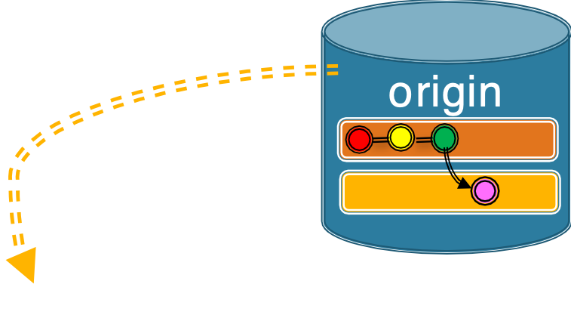
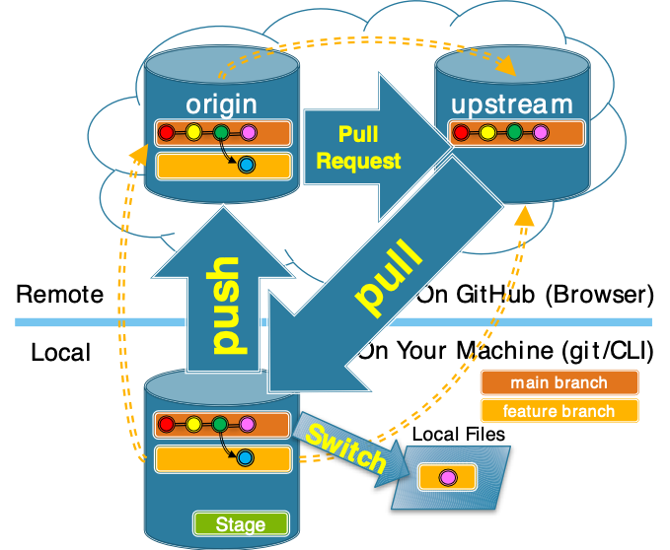
Sync with Upstream Main
1. switch to main
2. pull from upstream
3. push to origin
3.5 Git Terminology: Merge Conflicts
Notes:
Often while you are developing, changes will be made to the upstream repository. To keep your branch consistent with it, you should pull the changes and merge them.
In order to resolve the merge conflict you will need to
- Get the updates to the upstream main
- into your local repo
- also good idea to push to origin
- just to keep everything in sync.
Then you will resolve the merge conflict
- in your local repo
- on your machine
- then push the result up to your origin

Slide 46
Resolving a Merge Conflict
Upstream changes are merged from main into your feature branch.
Time
main
hasPig
Old MacDonald had a farm
And on that farm, he had a cow
With a moo moo here
And a moo moo there
Old MacDonald had a farm
And on that farm, he had a pig
With a oink oink here
And a oink oink there
Old MacDonald had a farm
And on that farm, he had a cow
With a moo moo here
And a moo moo there
Old MacDonald had a farm
And on that farm, he had a piglet
With an oink oink here
And an oink oink there
Old MacDonald had a farm
And on that farm, he had a cow
With a moo moo here
And a moo moo there
Old MacDonald had a farm
And on that farm, he had a piglet
With an oinky oink here
And an oinky oink there
Feature Branch
Merged Result
Main Branch
3.5 Git Terminology: Merge Conflicts
Notes:
With the upstream changes now in the main branch in your local repo
You resolve the conflict by
- merging the changes
- from the main branch
- into your feature branch
Here the merge commit is in the hasPig branch
- it blends the changes in the fuschia and blue branches
For example, here:
- piglet is taken from main (because piglets are cute)
- the line “an oink oink” is blended from the two commits:
- an is taken from the main branch (because it is better grammatically).
- oink oink is taken from the feature branch (because the sounds are always the same in the song).
- The merge commit used a blending of the two colors to indicate the merge.
- I.e. not a white ring like in the automatic merge earlier.
- The merge commit is then added to the end of your feature branch.
Might seem backwards
- We want the changes in main
- Ask: Why not merge into the main branch?
- recall that we don’t ever merge into main
- we leave that to the maintainers
- If we don’t, then we get into the problem were we can’t fast forward our main branch from the upstream.
By doing the merge
- We have told git how we want conflicts between the blue and fuchsia commits to be resolved.
- The blue/fuchsia merge commit contains that information.
- Doing so ensures that the maintainers will now be able to merge the feature branch automatically.

Slide 47
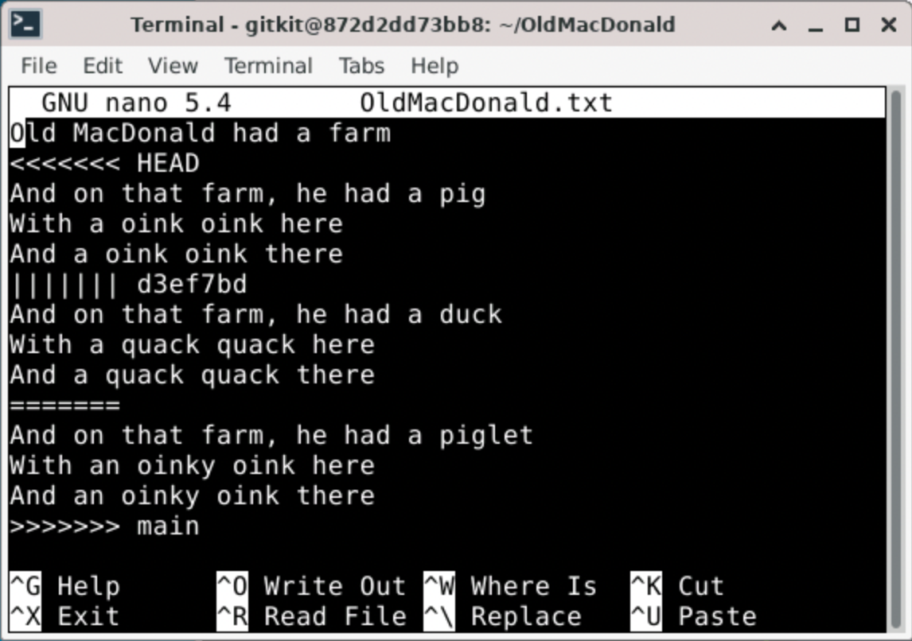
Raw Merge Conflicts
Feature
Branch
“Chevrons”
<<<<<<
>>>>>>
Best Common
Ancestor
main
Branch
3.5 Git Terminology: Merge Conflicts
Notes:
When a merge conflict occurs
- git will place text directly into the conflicting files
- to represent the conflict
Note that the content here does not correspond exactly with the prior examples…
- but it still illustrates how merge conflict information is displayed in the text files.
Ask
- What do you think we are seeing here?
- the three versions of the conflicting content
- the feature branch
- the best common ancestor
- the main branch
The conflict is indicated by
- “Chevrons”
- Aligned V shapes
- Often on military uniforms to indicate rank
- also often used for directional road markings.
The other symbols
- ||||||| fc40270
- the SHA of the best common ancestor
- ======
- just a divider before the main branch.
You can simply edit the file:
- Open it in any editor you want
- Make everything between the chevrons look the way you want.
- Just edit it down to the correct blended version.
- Remove the chevrons
- Save and exit

Slide 48
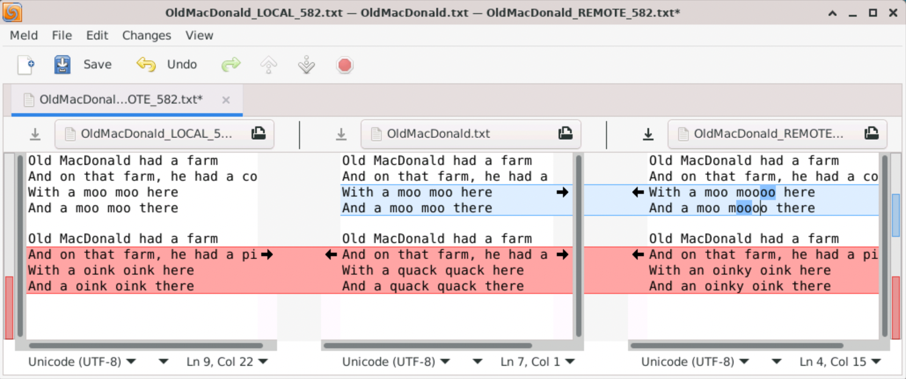
Using a Graphical Merge Tool (e.g. Meld)
Ancestor /
Result
Feature Branch
Main Branch
3.5 Git Terminology: Merge Conflicts
Notes:
The GUI merge tool will display the same information
In a way that makes it a little easier to work with.
Colors:
- red indicates conflicts
- blue indicates changes but not conflicting
Action:
- Goal is to make the middle pane into what you want
- click arrows to move changes to the middle pane.
- edit the middle pane directly
- Save
- Exit
Another nice thing about the GUI tool is if there are multiple conflicts
- the Up and Down arrows at the top
- will move you to the next or previous conflict.
Most IDE’s will have some sort of integrated merge tool.
- Eclipse, VSCode/VSCodium
- whatever you happen to use.
- They all display the same information
- Just in slightly different ways.

Slide 49
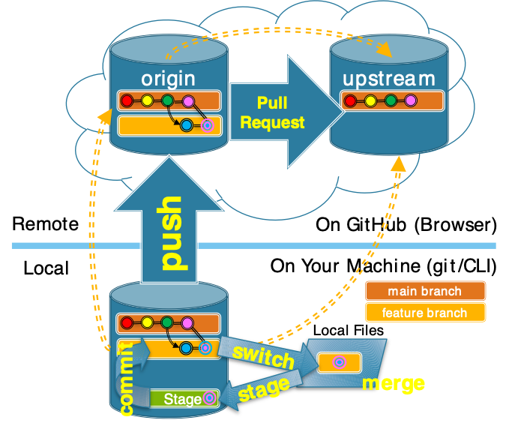
Big Picture: Resolving a Merge Conflict
3.5 Git Terminology: Merge Conflicts
Notes:
Here we just have it all together.
- we already synchronized
- we switch to the feature branch
- perform the merge to resolve the conflict
- Note that this will mean that you have changed the local files!
- Edited them by hand
- or used a GUI tool
- So these changes need to be staged and committed.
- stage the changes
- commit the changes
- push the feature branch
- recall that this will automatically update the PR
- and now it will be able to be merged automatically.
This is where you will want to get to by the end of the activities for this topic.

Slide 50
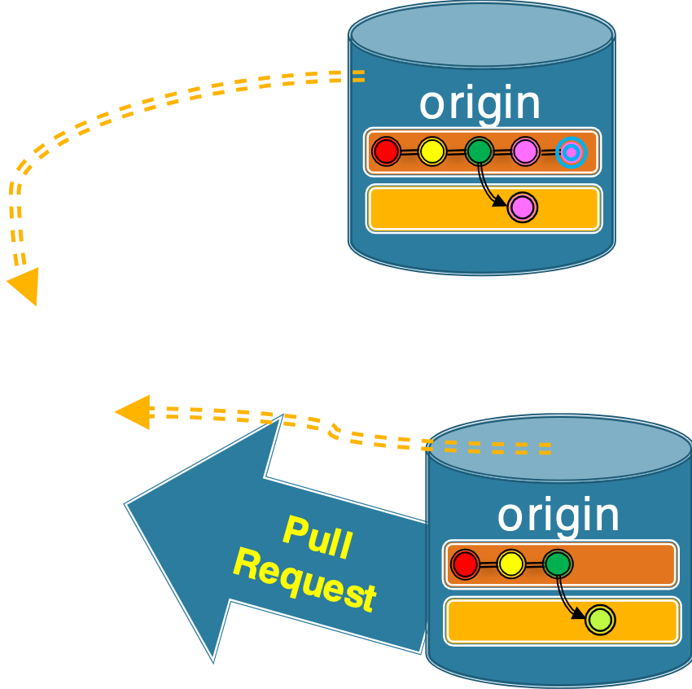
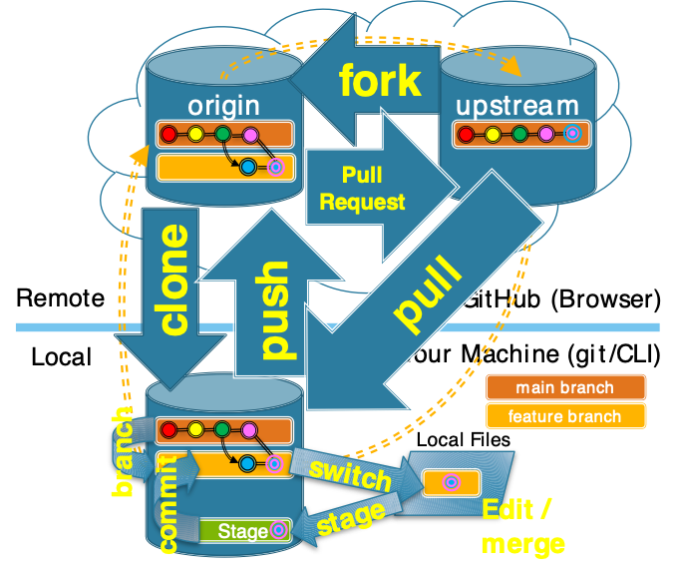
Big Picture: The Whole Messy Thing
3.5 Git Terminology: Merge Conflicts
Notes:
No need to spend much time here.
If you can look at this and remember
- what each of the yellow terms means
- how it relates to the others
- sequence them into a workflow
Then you are in good shape.
- if not keep this handy
- review a little
- make more sense of it little by little.

Slide 51
Outline
git and GitHub: Terminology and workflow
Editing and committing changes
Merging
Merging automatically
Handling merge conflicts
Extras
Acknowledgments

Slide 52
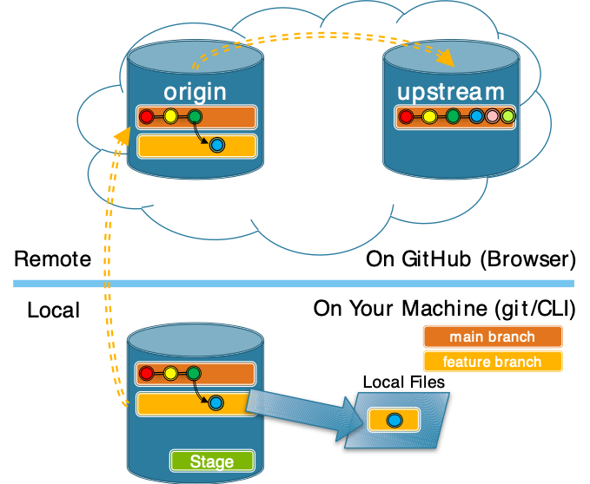
GitHub and Git: Out of Sync
4. Extras
Notes:
The maintainers merged your changes (blue)
But may also have merged changes from others (pink, lime)
So at this point:
- the main branch in your origin is not the same as in the upstream
- the main branch in your local repo is not the same as in the upstream.
And recall that
- all new work is supposed to begin from the end of the main branch.
So now if you wish to make another contribution
- You need to get the updated main branch.
- You need to get those changes to the main branch
- into our origin repository
- into our local repository

Slide 53
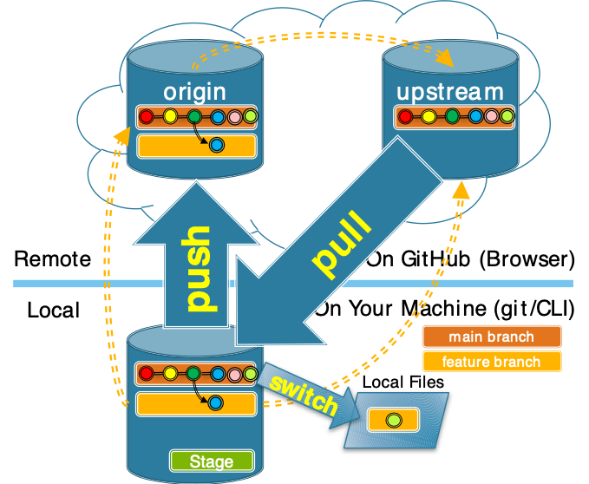
GitHub and Git: Sync with Upstream
1. switch to main
2. pull from upstream
3. push to origin
upstream
remote
Fast-Forward Merge
New commits can be added to the end of the branch.
4. Extras
Notes:
This is a 3 step process.
- Switch to the main branch
- because that is what we want to update.
- Pull the main branch from the upstream.
- This gets the new commits from the upstream main
- appends them to the end of your main branch
- Push your main branch to the origin.
- makes your main there look like your local main.
Note: One other thing that will need to be done.
- The dotted orange line from local to upstream is new.
- Need to establish that connection so your local knows about the upstream.
- [click] Called “Setting the upstream remote”
This works easily because you never changed the main branch!!
- So the blue commit can always be built on top of the green one
- and the pink one on top of the blue one
- and the lime one on top of the pink one.
Do you think the order that the maintainers added these commits matters?
- No. They were all carefully engineered so that they didn’t conflict.
- any commit they put after green could have been put on the end of your main.
- so as long as none of them conflict and all build from green its going to work.
- Imagine each commit being to a different file.
- this is what was done in the prior homework
- All of the issues were carefully created so that they were in different files or different parts of the same file.
This is the reason we don’t commit to main.
- As long as you don’t commit to main,
- any commits added to main by the maintainers
- can simply be added onto your main
[click] This is called a “Fast-Forward Merge”

Slide 54
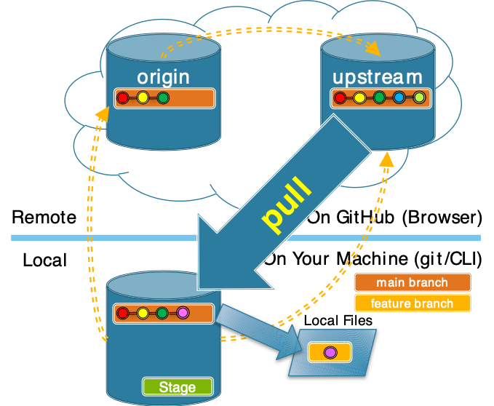
Don’t commit to the main branch!
RULE: Only commit to feature branches. Maintainers will merge accepted changes into the main branch.
What has happened and what can go wrong here?
4. Extras
Notes:
The fast-forward merge we just saw works because we didn’t commit to main.
That is we followed our RULE:
- You should only ever commit to feature branches.
Let’s see what happens when you don’t follow the rule!!
Consider this picture.
Activity:
- Small groups discuss and answer the questions:
- What have you done?
- What have the maintainers done?
- What could go wrong when you pull?
- Are there conditions when everything would be okay?
- are they realistic?
Discussion Points:
- you made a commit to main (fuchsia)
- maintainers merged commits into main (blue, lime)
- When you try to pull there could be a problem…
- What order would the commits appear in in your main?
- And then your main would still not be synchronized with the upstream!
- Also imagine…
- The blue commit builds on the green one
- Your fuchsia commit builds on the green one
- How might that be a problem?
This is why you never commit to main.
- So long as you haven’t added any commits to main
- The changes made to main by the maintainers are easily added to the end of your main
- There will never be a conflict.
- That is they can be added via a “Fast Forward Merge”

Slide 55
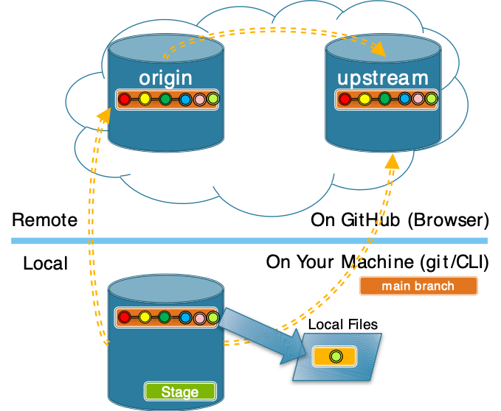
GitHub and Git: Delete Feature Branches
4. Extras
Notes:
Notice that main now contains all of your changes
- so there is no need to keep your feature branches.
- they can be deleted.
Once they are deleted
- you are back in sync with the upstream
- back to where you are ready to start new work
You may have emotional attachment to your branches…
- you worked hard on them!
- it’s fine you can keep them if you like
- eventually you’ll realize its not necessary
- and they clutter things up when you have too many.
- then you’ll feel comfortable deleting them.

Slide 56
Acknowledgments:
Slide Template From:
https://creativecommons.org/licenses/by/4.0/
Slide Content Licensed as:
https://creativecommons.org/licenses/by-nc/4.0/
Slide Content also from: https://people.irisa.fr/Anthony.Baire/git/git-for-beginners-handout.pdf

