Slide 1
CSC/ECE 517 Roster Summary
Fall 2024

Slide 2
Where do we come from?
Country
State/Province
Hometown
Undergraduate school

Slide 3
Country
India – 26
United States – 17
China – 3
Germany – 1

Slide 4
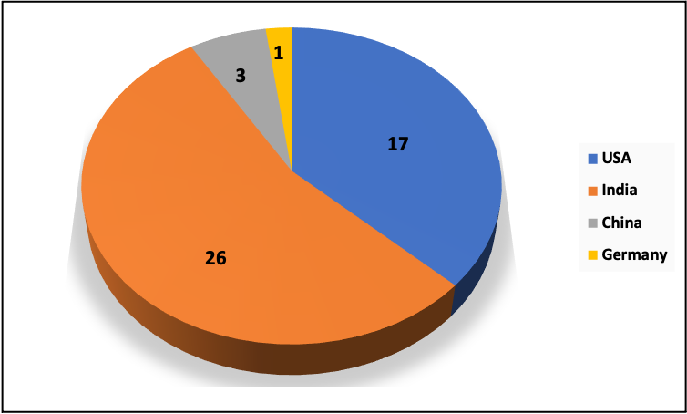
Country

Slide 5
State/Province
North Carolina – 17
Maharashtra – 9
Andhra Pradesh, Telangana – 4
Tamil Nadu, Gujarat – 3 each
Karnataka– 2
Others - 1 each (total: 9)

Slide 6
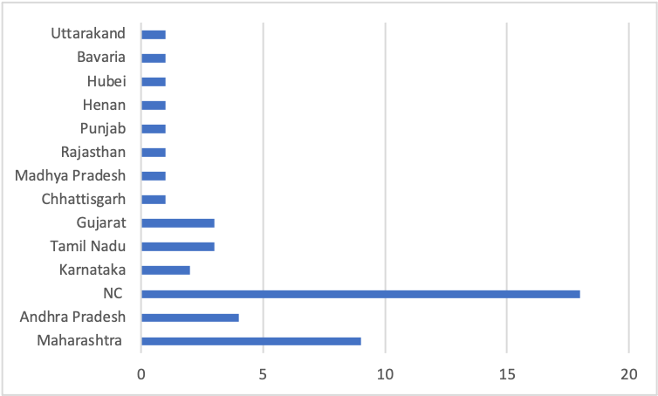
State/Province

Slide 7
Hometown
Mumbai, Pune – 4 each
Cary – 3
Chennai, Hyderabad, Apex, Bangalore – 2 each
Others – 1 each (total: 28)

Slide 8
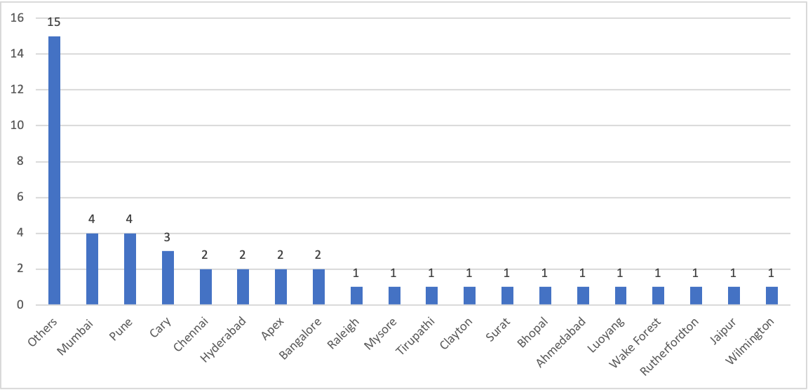
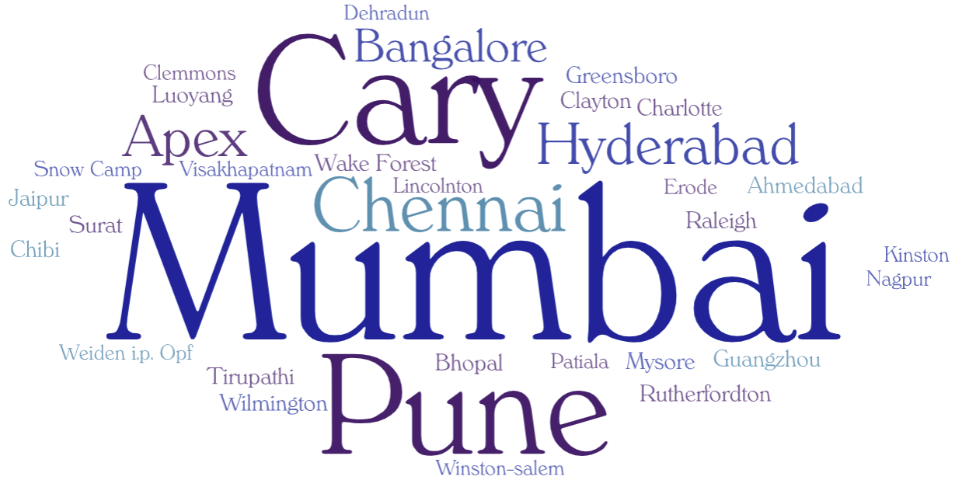
Hometown

Slide 9
Undergraduate School/University
NC State University – 14
KJ Somaiya College of Engineering, Manipal Institute of Technology, Pune Institute of Computer Technology – 2 each
Others – 1 each (total: 27)

Slide 10
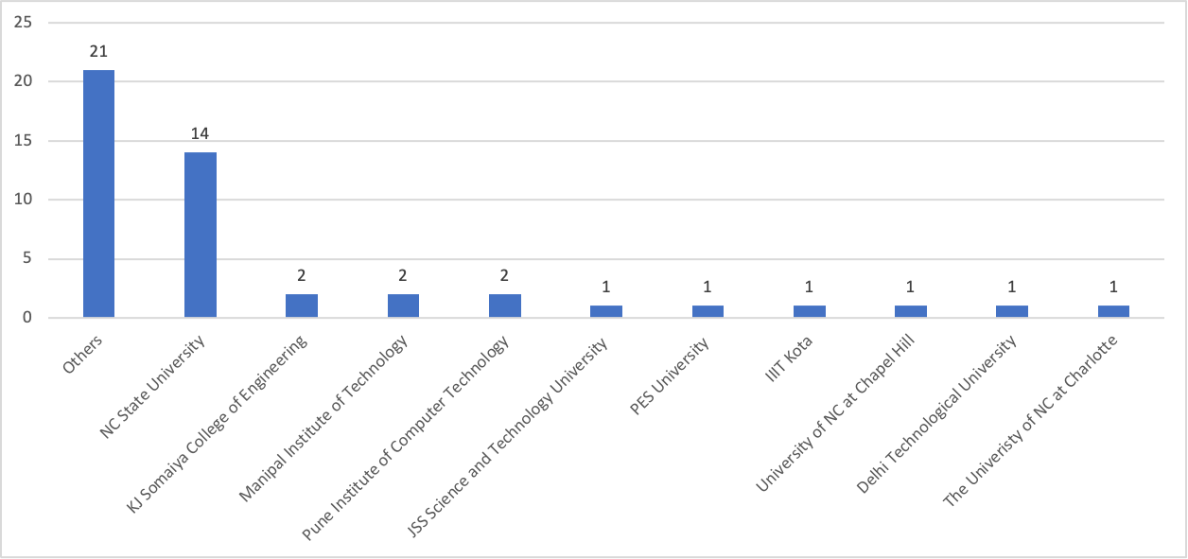
Undergraduate School/University

